Slide 1
Week in Review
April 26, 2020
Nathan Price

Slide 2
Learn Autocad Fusion 360 in 30 Days
Notes:
Learn Autocad Fusion 360 in 30 Days
https://www.youtube.com/playlist?list=PLrZ2zKOtC_-DR2ZkMaK3YthYLErPxCnT-

Slide 3
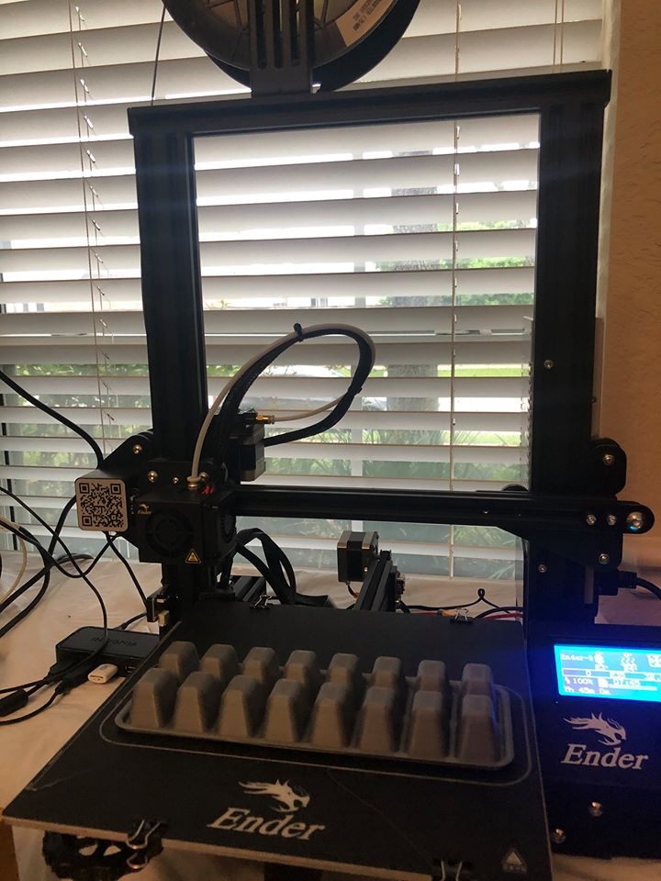
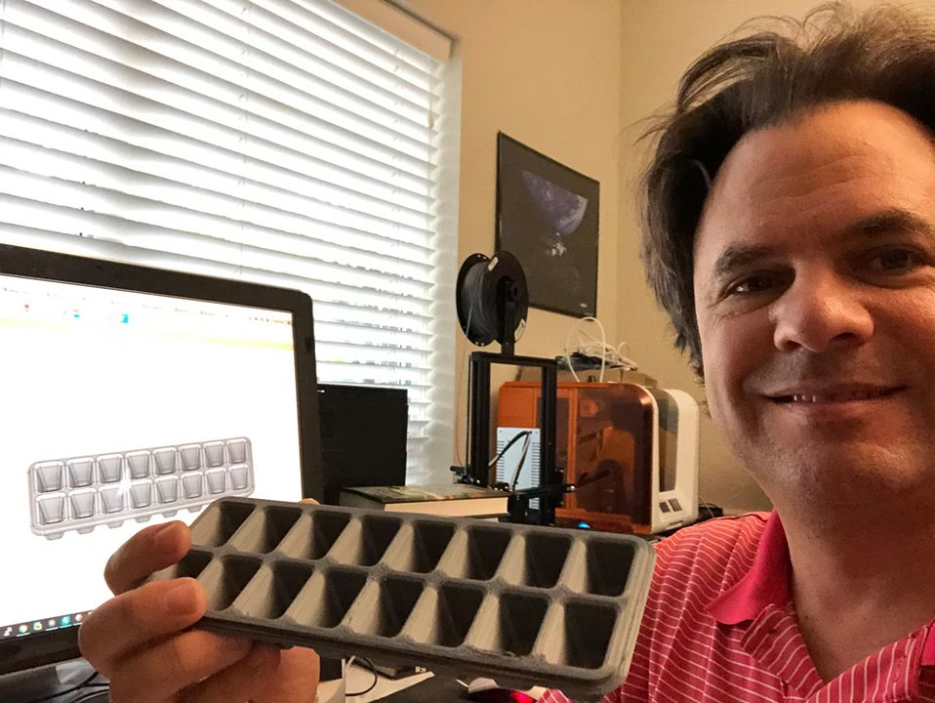
Day 5: Ice Cube Tray
Learned:
Sketch Dimension
Extrude Cut
Rectangular Pattern Feature

Slide 4
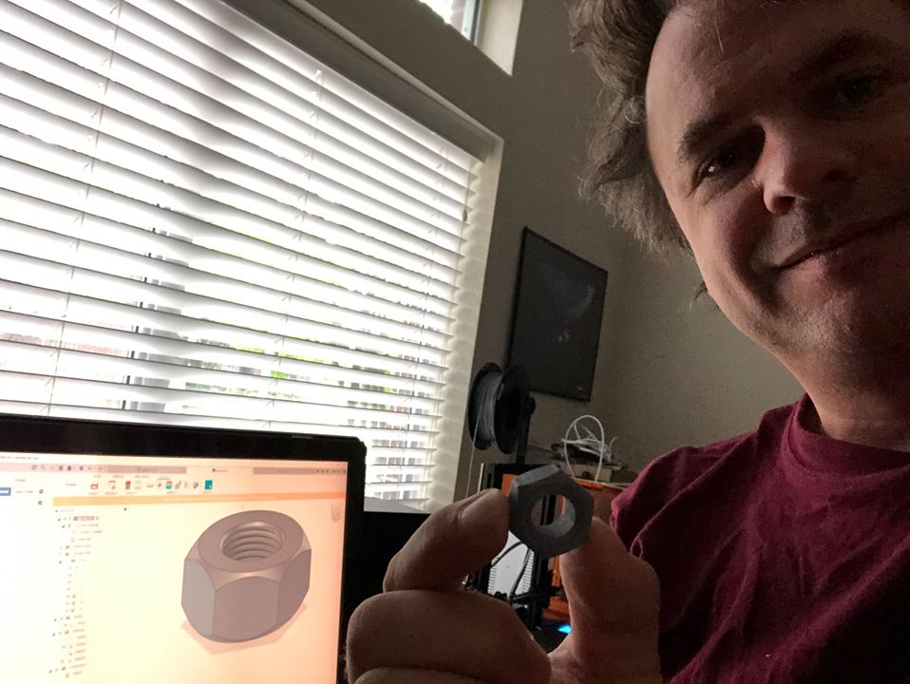
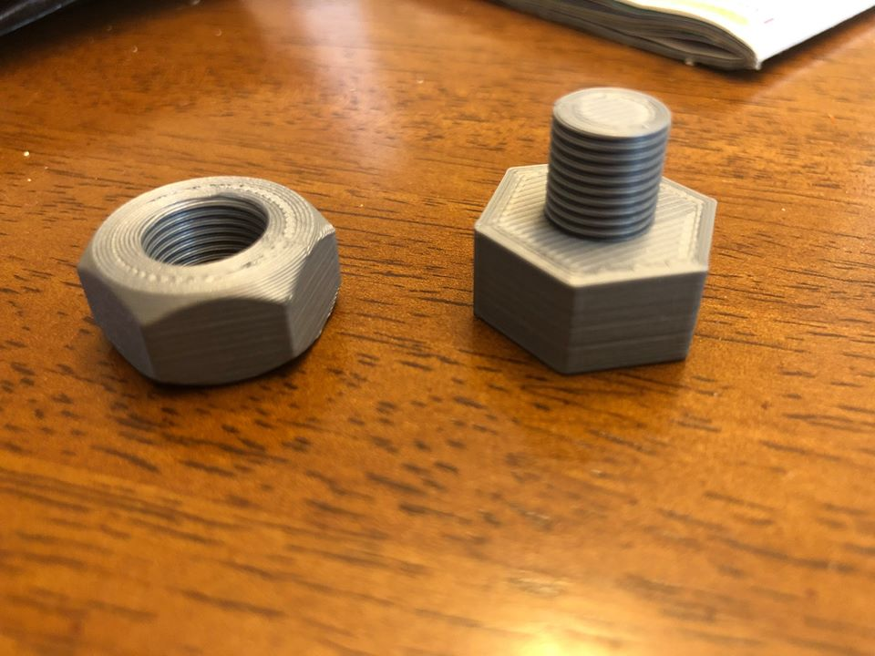
Day 6: Hex NUT
Learned:
Polygon Sketch
Create Midplane
Mirror Feature
Hole Featured
Learned a new term “Chamfered Edge”

Slide 5
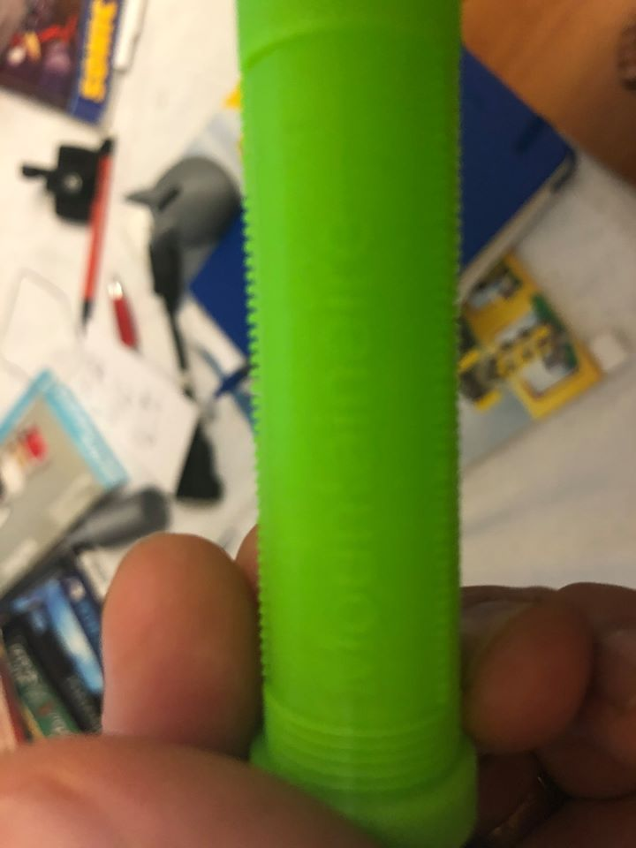
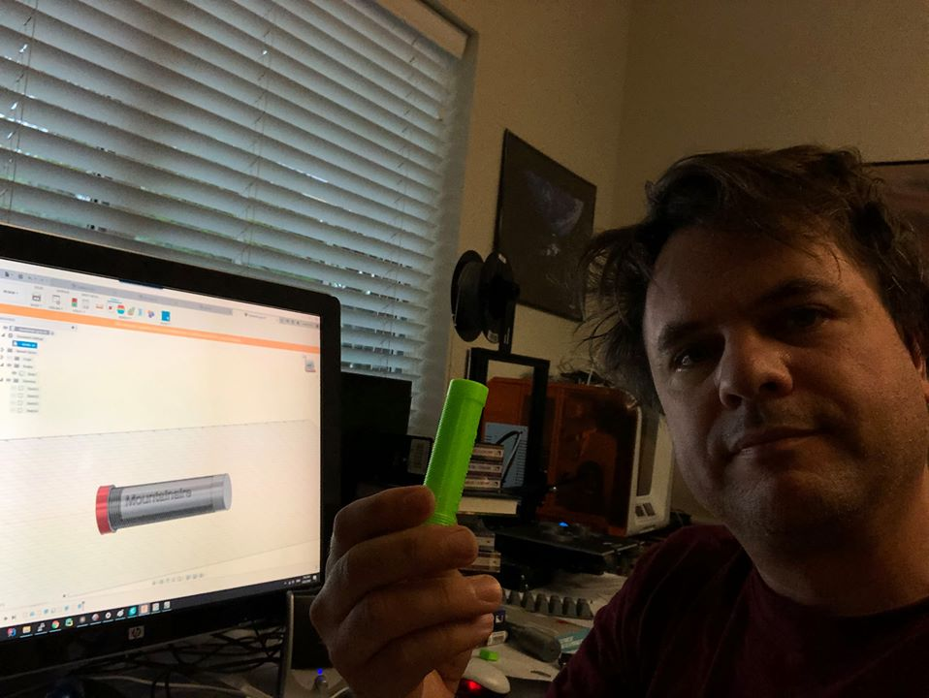
Day 7: Bike Handle Bar
Learned
Press Pull
Create Text
New Body

Slide 6
Countdown To the Moon

Slide 7
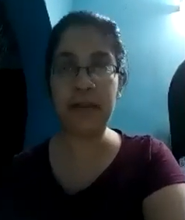
1710 - Drishti
Lives in India
Did not know about NASA’s plans to land on the Moon in 2024
Does not think most people know about it because they are focused on their local/immediate concerns
Thinks exploration is important
Notes:
https://www.countdowntothemoon.org/2020/04/25/1710-drishti/

Slide 8

1711 - Saif
Lives in Pakistan
Had not heard of NASA’s plans to visit the moon
Is supportive of Space Exploration
Would like to go to space if it were possible
Would like to for us to host a 3D Design/Printing session for his community online
Notes:
https://www.countdowntothemoon.org/2020/04/24/1711-saif/

Slide 9

1712 - Jalees
Lives in Pakistan
Did significant research ahead of the chat and was best informed
Believes in the “abundance mindset” There is enough for each of us, and we can all make what we have into something more
Supportive of Space Exploration
Would like to

Slide 10

1713 - Jason

Slide 11
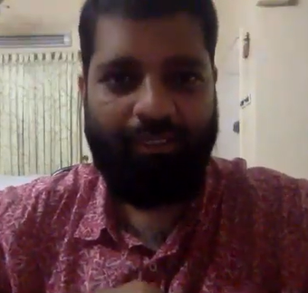
1714 - Ahsan

Slide 12
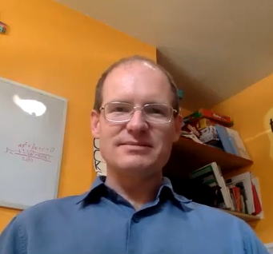
1715 - John

Slide 13
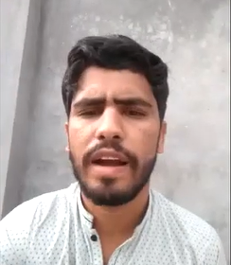
1716 –engr Muhammad Aqib

Slide 14

Plans for the coming Week

Slide 15
Plans for the Coming Week
7 more Countdown To The Moon interviews
Start back with the “Learn Autocad Fusion 360 in 30 days” course in later part of the week
Read “1066 The Year of the Conquest” by David Howarth

