Slide 1
Python Lesson
Week 01

Slide 2
What we will accomplish today
Install Python on your computer
Using IDLE interactively to explore
  String
  Variables
  if/else
  while
  Boolean logic
  Integers
Create Python files

Slide 3
Install Python
Go to https://www.python.org/downloads/windows/
Download - Python 3.4.3 – (Release Date 2015-02-25)
  Windows x86 MSI installer (32 bit)
  Windows x86 MSI installer (64 bit)
Create a folder C:\Projects to store your projects files.
  Create a sub folder week01
Launch IDLE

Slide 4
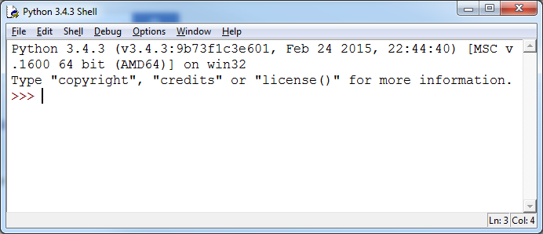
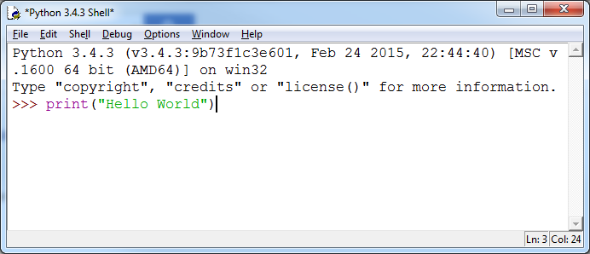
Python Shell – Your first Python commands
Open IDLE
At the “>>>” type
  print(“Hello World”)
Press <enter>
What do you see?
Try typing this with other
words

Slide 5
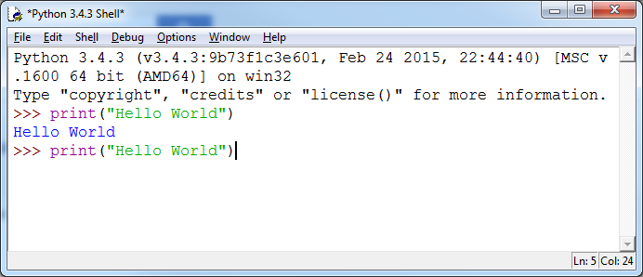
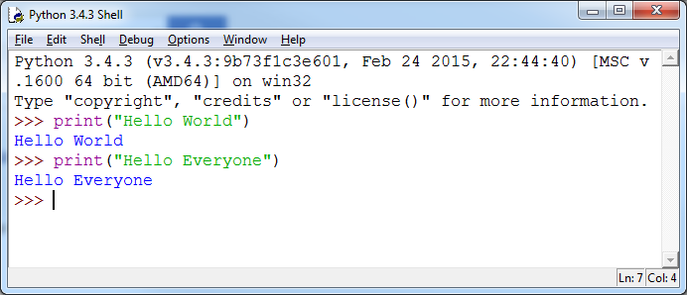
It would be great to not have to type so much
<Alt> + P
Will copy down the previous line
Then you can edit it
This can work to copy down even earlier commands

Slide 6
Let’s play with Strings
A string is a sequence of characters.
print your name
print “yesyesyesyes”
print “MaybeMaybeMaybe”

Slide 7
Easier ways to repeat yourself
print(“yesyesyesyes”)
print(“MaybeMaybeMaybe”)
But take a look at this:
print(“yes” * 4)
print(“Maybe” * 3)

Slide 8
String Concatenation
You can use + to combine strings.
For example:
print(“string1”+ “string2”)

Slide 9
Easier ways to repeat yourself
print(“MaybeMaybeMaybeYesYesYesYes”)
Could be as easy as:
print(“Maybe” * 3 + “Yes” * 4)

Slide 10
Delimiting Strings
Don’t forget to save time with
<ALT> + P
You can use single quotes or double quotes. But whatever you start with you need to end with.
For example these are valid:
print(“I am a String”)
print(‘I am a String’)
This is valid too:
print(“I ‘m a String”)
print(‘Some people say, “I am a String”’)

Slide 11
Escape characters
Sometimes you need to say this character means something different than usual.
In Python this is done with the backslash “\”
For example, sometimes you want to use the delimiter as an ordinary character.
print(‘I \‘m a String’)
print(“Some people say, \“I am a String\””)

Slide 12
Other escape characters
\n - newline
\t - tab
print(“I am line 1\nI am line2”)
print(“Name\tAge\nNathan\t39”)

Slide 13
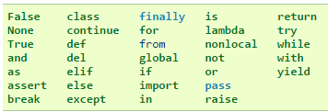
Using Variables
You are not allowed to use following keywords as variable names
firstName = “Nathan”
lastName = “Price”
print(firstName)
print(lastName)
Variable Name - Any meaningful combination of characters; The characters must all be letters, digits, or underscores _, and must start with a letter. In particular, punctuation and blanks are not allowed.
Important to remember : Python is case sensitive: The identifiers last, LAST, and LaSt are all different.
Good Practice: Use camelCase when naming a variable with multiple words – example: interestRate

Slide 14
Getting input from the user
userName = input(“What is your name? ”)
print(“Welcome “ + userName)
*Change it so the user enters their name on a blank line.

Slide 15
Let Us Start Writing Programs
Create a File->New
print(“Something”)
File->Save as “programname.py” in folder week01
Run first program – Run Module (F5)
Keyboard shortcuts
  Ctrl+N as File->New
  Ctrl+S as File->Save
  Ctrl+Z as Edit->Undo
  F5 – Run Module

Slide 16
Finding the length of strings
len() can be used to find the length of strings
len(“Hello”)
5
len(“12345”)
??

Slide 17
Exercise
Create a new file called “NameLength.py”
Write a program that asks the user and stores it in a variable
Tell the user how long their name is

Slide 18
String Functions – fun with case
string variables and literals have functions you can use on them.
Let’s take a look:
print(“hello”.upper())
firstName = input(“What is your first name?\n”)
print(“Did you say,\”” + firstName.upper() + “\”?”)

Slide 19
Try these and tell me what they do?
lower()
capitalize()
swapcase()
title()
See more string functions at: https://docs.python.org/3/library/stdtypes.html#string-methods

Slide 20
Exercise
Write a program that asks for a person’s full name
And responds back with “Welcome Firstname Lastname” with the case correct.
For example, if I type “nathan price” it would say
“Welcome Nathan Price”

Slide 21
Working with parts of strings
You can just get one character from a string by using “[]”.
For example, if I want the first character I could type in
print(“This is a string”[0])
This would print “T”
Now try to print the 4th letter

Slide 22
The 2nd and 4th character in your name
Write a program that asks for the users name
Makes it all upper case
And then says, “The second character is ‘A’ and the fourth character is ‘H’)

Slide 23
You can count the other way
What is printed when you type:
print(“Something”[-1])

Slide 24
Exercise
Take your previous program and add a new statement
“The last character in your name is ‘N’”

Slide 25
“Assignment” vs. “Comparison”
One equal always means “assign”. It makes the two things equal
myName = “Nathan”
Now “myName” is the same as “Nathan”
Two equals is asking the question “are these equal?” and the computer will decide if it is “True” or “False”
myName == “Nathan”
Asks the question, “Is myName the same as ‘Nathan’?” and will return either True or False

Slide 26
“if/else” statement
***Indention is very important in Python***
Create a new file (NameCheck.py) and type this program exactly:
name = input(“What is your name?\n”)
if name == “Nathan” :
print(“Welcome. You may enter.”)
else:
print(“Access Denied!!”)

Slide 27
Exercises
Create a program that asks people what state they live in. If “Texas” then tell them that they “Qualify” otherwise tell them “You need to move to Texas”
Create a program that has the user type in a sentence, if the last character is a “?”, the say “Why do you ask?” otherwise it should say, “That’s interesting.”

Slide 28
Combining conditions with “and”
sentence = input(“Type in a sentence.\n”)
if sentence[0] == “A” and sentence[-1] == “.”:
print(“I have heard that before.”)
else:
print(“That’s new.”)
What happens if I enter:
A bear walks into a bar.
How about:
A bear walks into a bar?

Slide 29
“while” statement
In addition to “if/else” you can create loops using “while”
Try this:
stop = “”
while not stop == “yes”:
stop = input(“Do you want me to stop? (type ‘yes’)\n”)

Slide 30
What is the final answer?
Rule:
  Parenthesis are evaluated first
  not is evaluated next;
  and is evaluated next;
  or is evaluated last.
False or not True and True

Slide 31
What is the final answer?
Rule:
  Parenthesis are evaluated first
  not is evaluated next;
  and is evaluated next;
  or is evaluated last.
False or not True and True
False or False and True
False or False
False

Slide 32
What is the final answer?
Rule:
  Parenthesis are evaluated first
  not is evaluated next;
  and is evaluated next;
  or is evaluated last.
False and not True or True

Slide 33
What is the final answer?
Rule:
  Parenthesis are evaluated first
  not is evaluated next;
  and is evaluated next;
  or is evaluated last.
False and not True or True
False and False or True
False or True
True

Slide 34
What is the final answer?
Rule:
  Parenthesis are evaluated first
  not is evaluated next;
  and is evaluated next;
  or is evaluated last.
True and not (False or False)

Slide 35
What is the final answer?
Rule:
  Parenthesis are evaluated first
  not is evaluated next;
  and is evaluated next;
  or is evaluated last.
True and not (False or False)
True and not False
True and True
True

Slide 36
Exercise
Evaluate
True and True
True and False
False and True
False and False
Not False
Not True
Not False and Not True
Evaluate
True or True
True or False
False or True
False or False

Slide 37
Integer Variables
count = 0
print(count)
count = count + 1
print(count)

Slide 38
Exercise
Write a program that prints the count from 0 to 5
0
1
2
3
4
5

Slide 39
+=
Adding an amount to a variable is such a common practice that there is a short cut.
These two do the same thing:
count = count + 1
count += 1
Rewrite your previous program to use +=

Slide 40
Exercise
Modify the following program to say how many times the person has been asked:
stop = “”
while not stop == “yes”:
stop = input(“Do you want me to stop? (type ‘yes’)\n”)

Slide 41
Exercise
Write a program that asks a person to type in a sentence and then it prints out every other letter.

Slide 42
Homework for the week:
Create a “MadLibs” program
Create a program that asks the person their name, and then asks them to type in one letter at a time. If they miss any letter, then say “Whoops!!”. But if they get them all then say, “Wow! You win!” (You will need to use a variable to store an integer containing the length of the name, and then you will need to have another integer starting at zero and then increment until you get to 1

Slide 43
Save for the next lesson

Slide 44
Exercise 3
Evaluate
-(-(-(-2))) == -2 and 4 >= 16**0.5
19 % 4 != 300 / 10 / 10 and False
-(1**2) < 2**0 and 10 % 10 <= 20 - 10 * 2
Evaluate
100**0.5 >= 50 or False
2**3 == 108 % 100 or 'Cleese' == ‘Cheddar'

Slide 45
str() [Alphanumeric]
String Formatting with %

Slide 46
More data types
Number data type
  Int
  float
Boolean data type
Determine data type of a variable – type()
Operator & Expression
  Arithmetic Expression - basic math ops, mod, exponent, floor division, parenthesis
  Comparison Operator – (==, !=, >, <, >=, <=)
  Assignment Operator – (=, += etc.)
  Boolean Operator – and, or, not

Slide 47
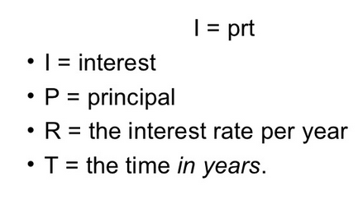
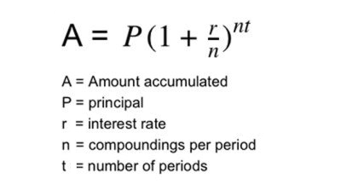
Exercise
Calculate Simple Interest
Calculate Compound Interest
Convert a temperature from Fahrenheit to Celsius

Slide 48
Exercise -2
Express
Is 17 less than 4 ?
Is 3 greater than equal to 1 ?
Is 40 multiplied by 2 equal to 40 plus 40 ?
Is square of negative 3 equal to 9 ?
What is the remainder when 340 is divided by 9 ?
What is the quotient when 23 is divided by 4 ?

Slide 49
What did we learn ?
Data Types
  Number
  String
  Boolean
Variables
Expression
  Arithmetic
  Logical

