Slide 1

Space and Our Future
Nathan Price

Slide 2
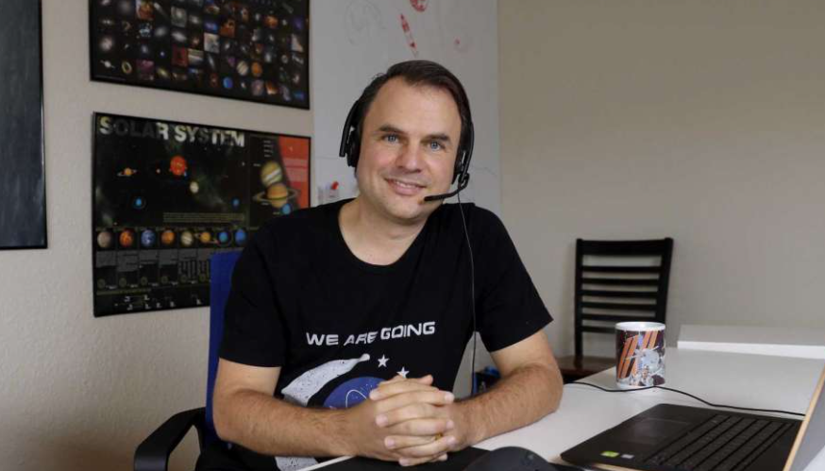
Nathan Price
Houston, Texas resident
Work for a software company
Passionate about space exploration and development
Founder of the North Houston Space Society (http://NorthHoustonSpace.org)
On a quest to interview a person a day till the end of 2024 as we Countdown to the Moon (http://CountdownToTheMoon.org)

Slide 3
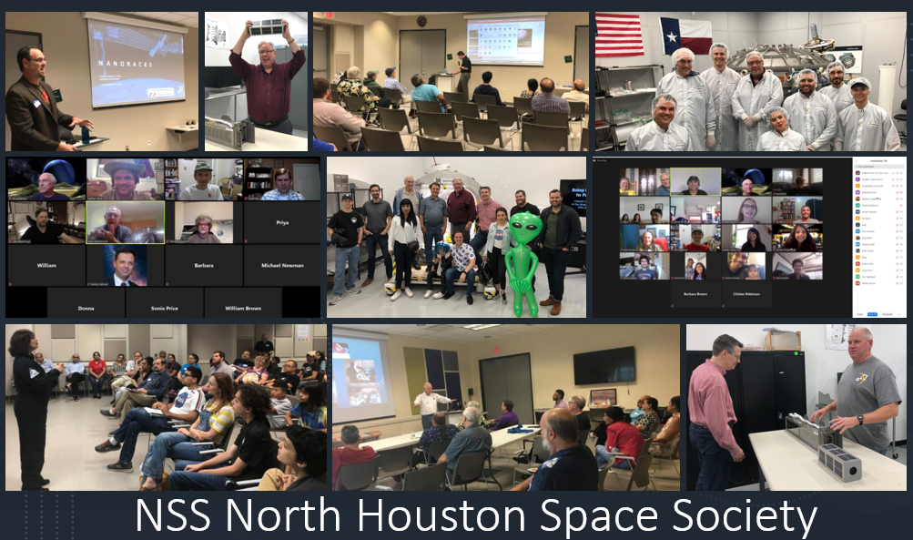

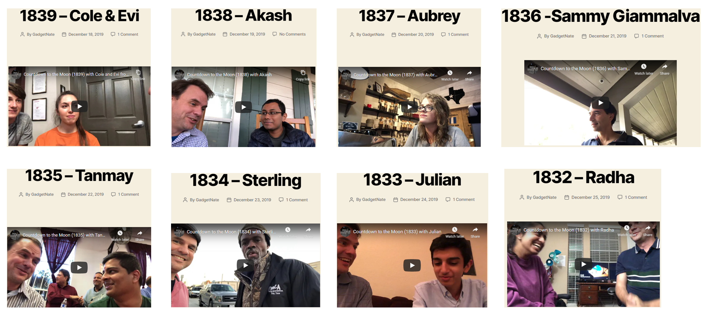
http://NorthHoustonSpace.org
Everyone welcomed to attend!!
I’d like to interview YOU!
http://CountdownToTheMoon.org

Slide 4
What is going on with Space?

Slide 5
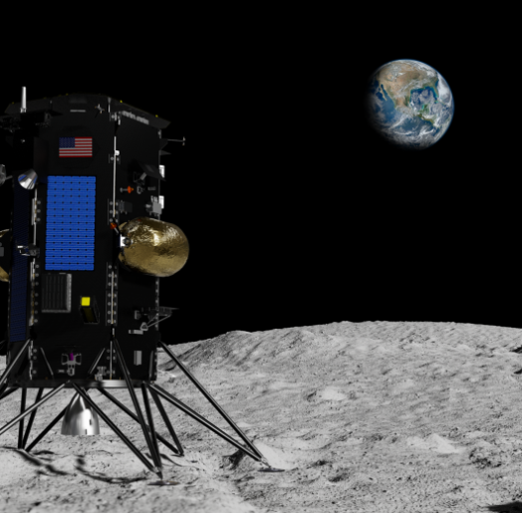

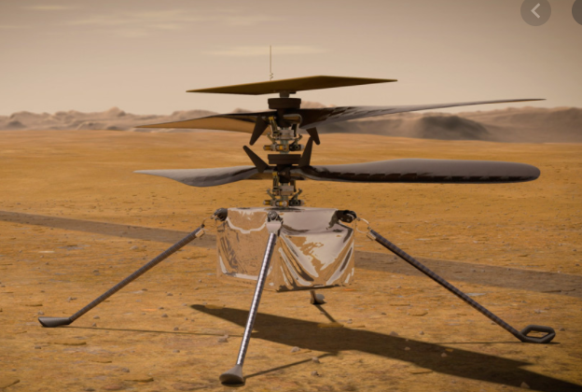
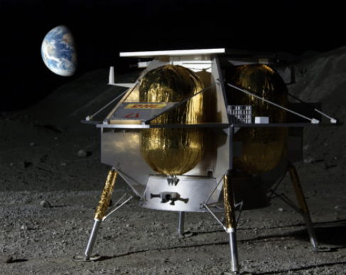
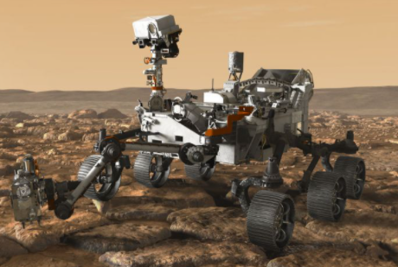

Slide 6
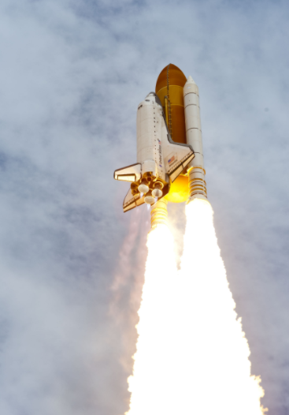
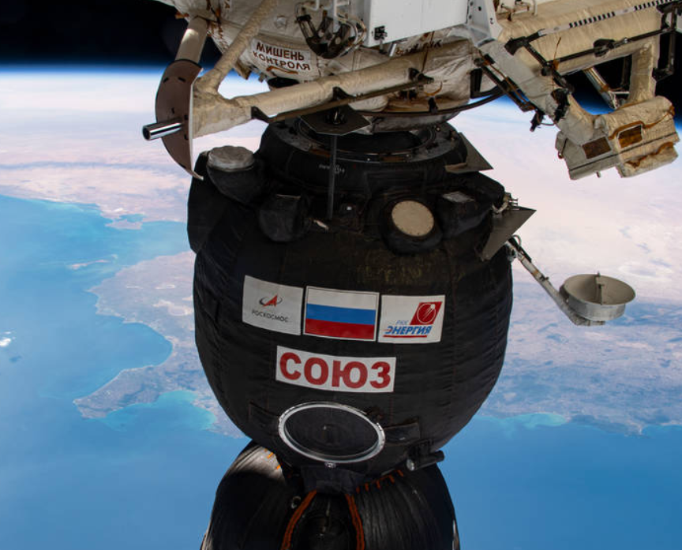
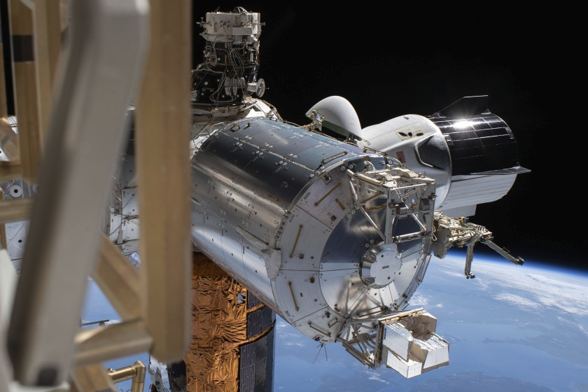
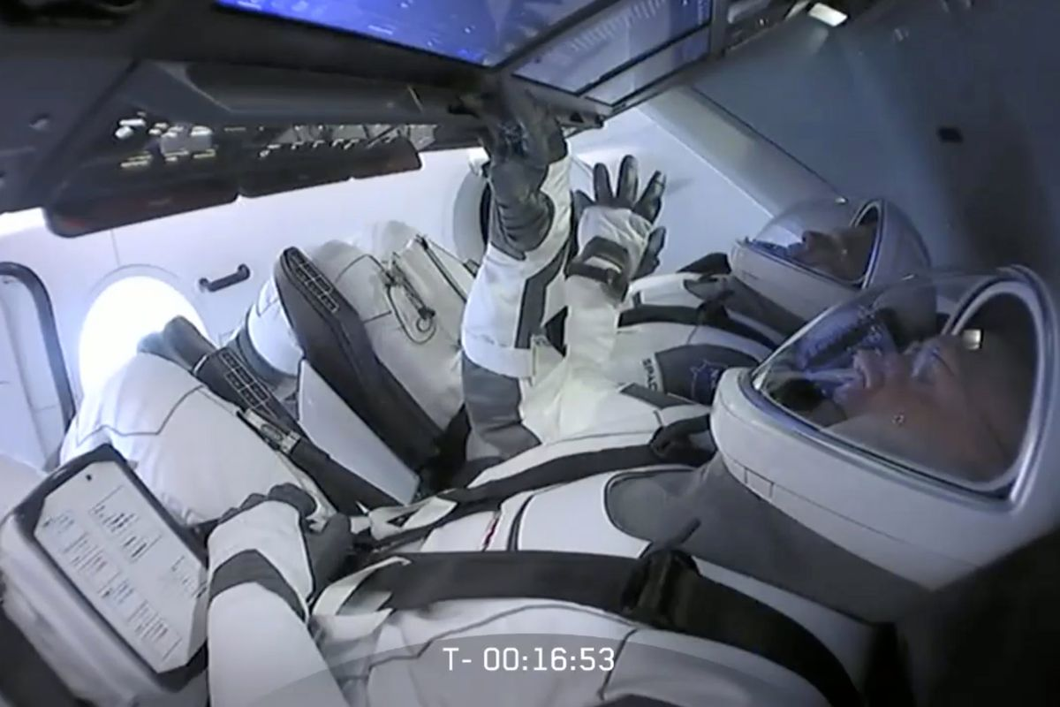

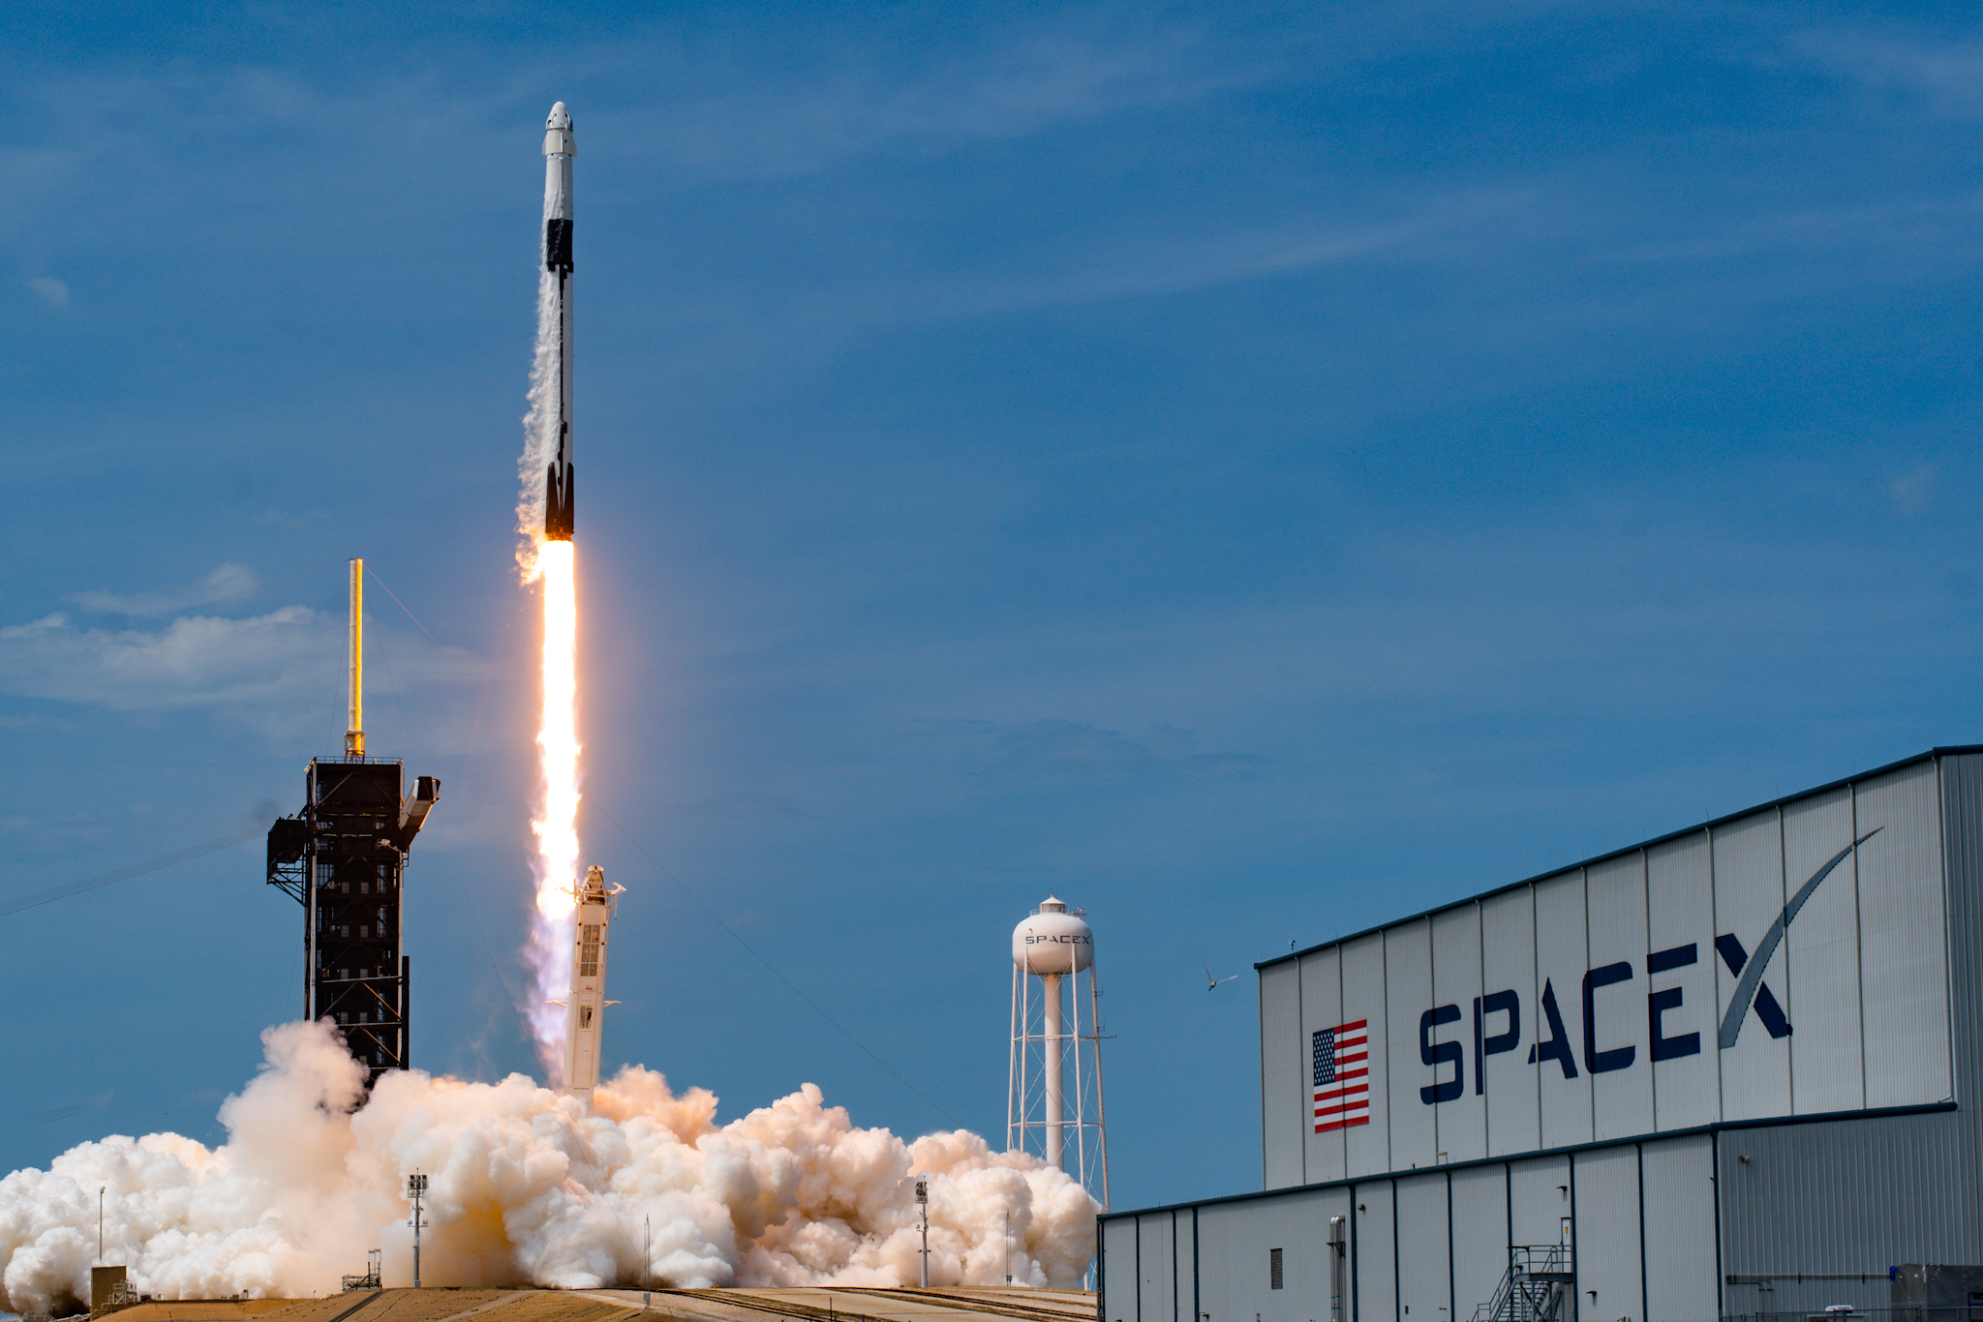
July 8, 2011
$80 million/person
$55 million/person

Slide 7
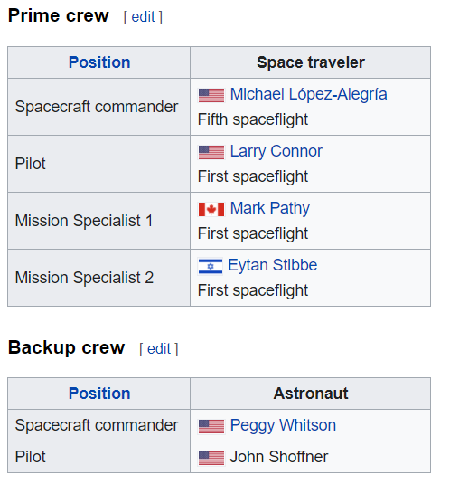



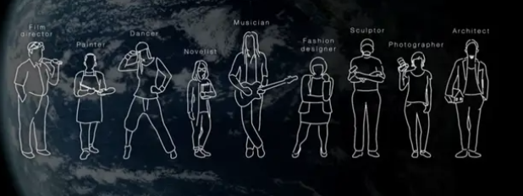
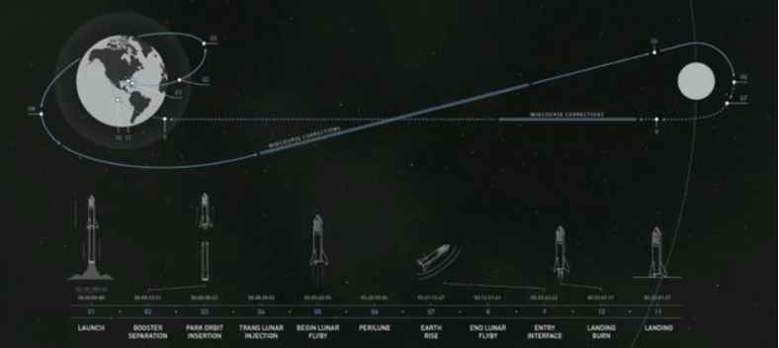

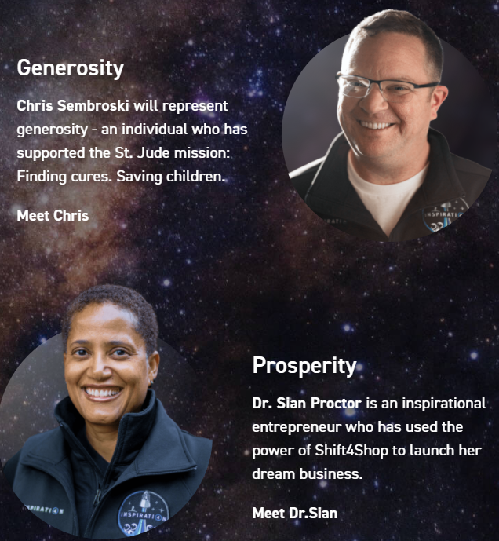

Slide 8
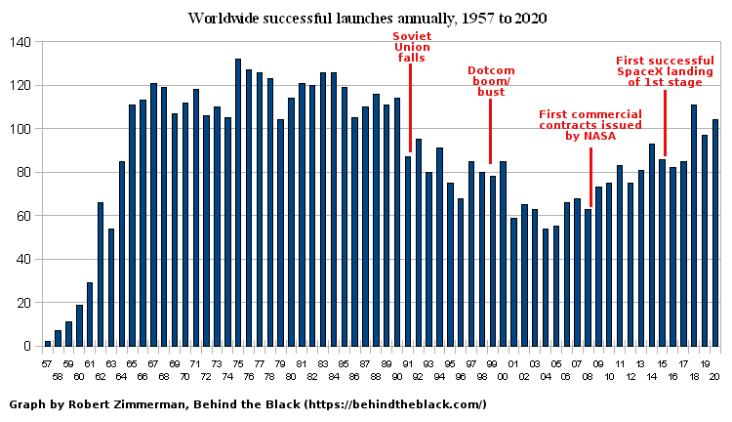
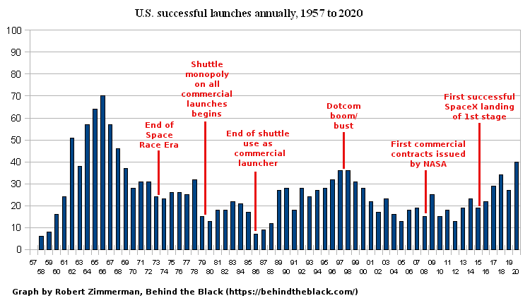
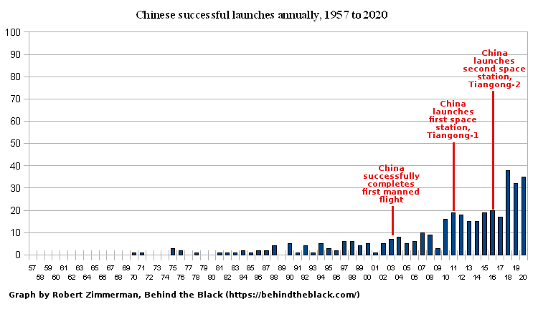
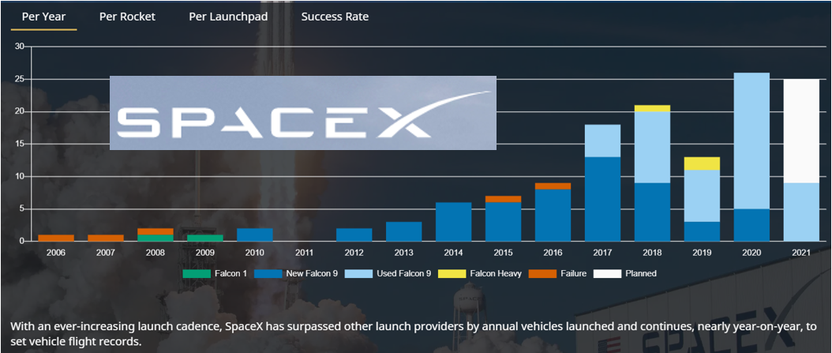

Slide 9

Project Artemis
NASA is committed to landing American astronauts, including the first woman and the next man, on the Moon by 2024.
We will collaborate with our commercial and international partners to establish sustainable missions by 2028.

Slide 10
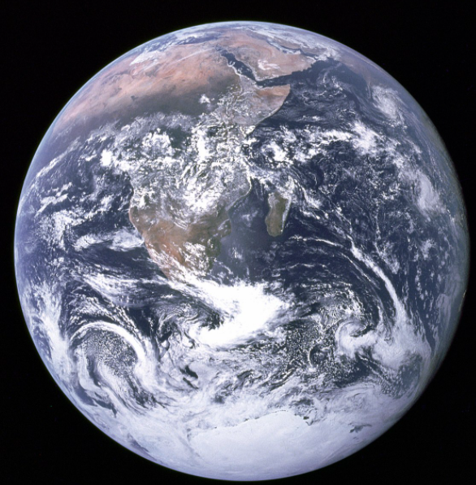
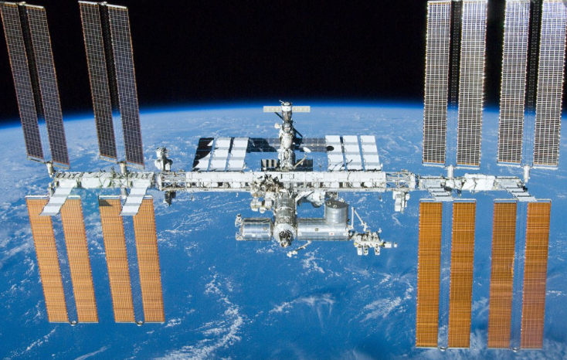
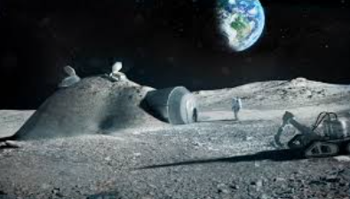
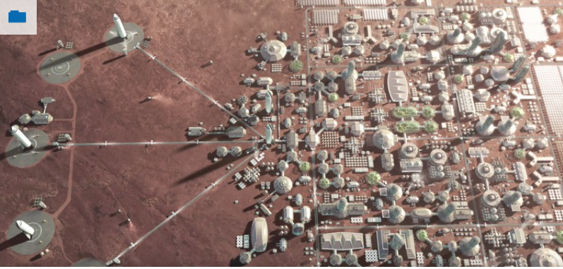
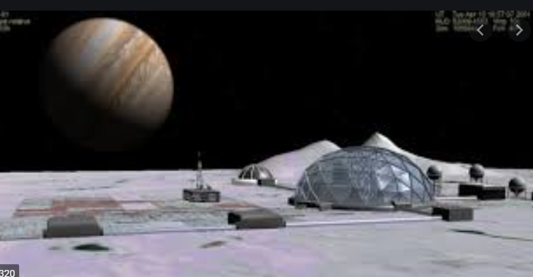
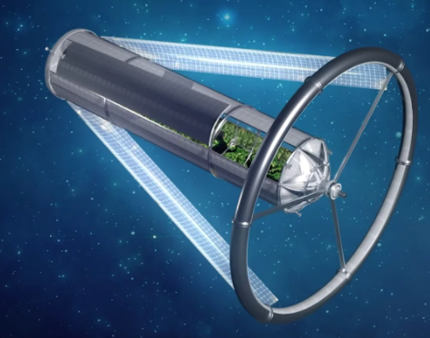

Choice about the future of humanity
ONLY EARTH
Everywhere

Slide 11


Slide 12
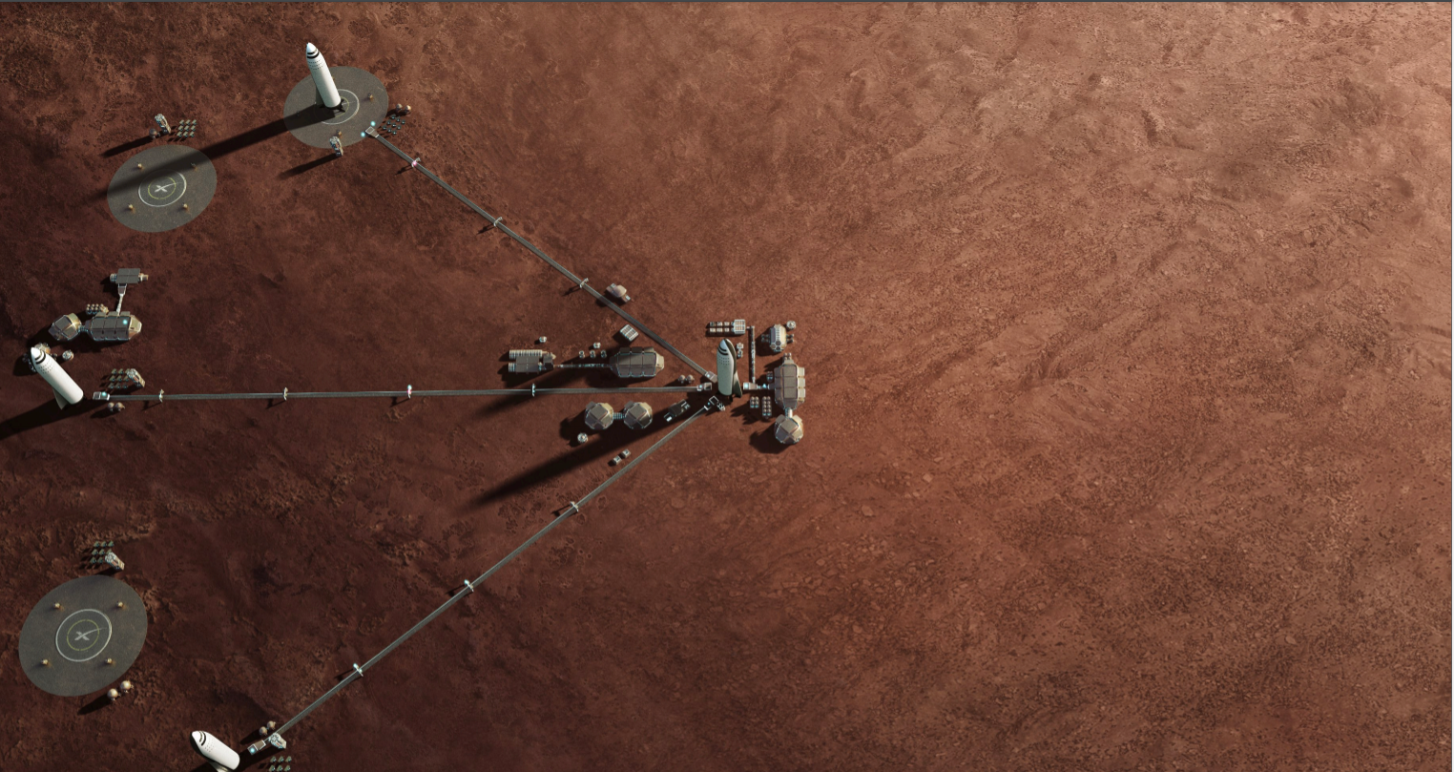

Slide 13
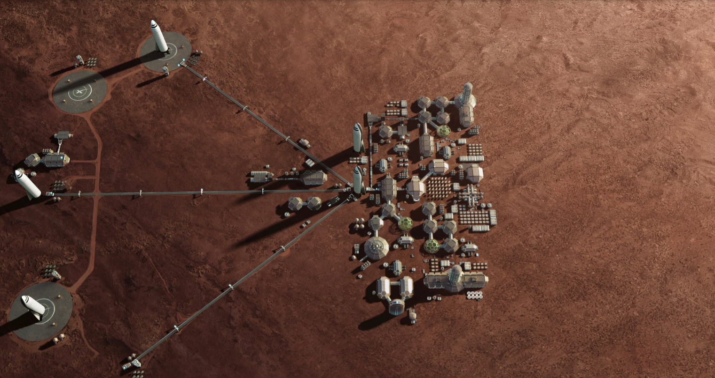

Slide 14
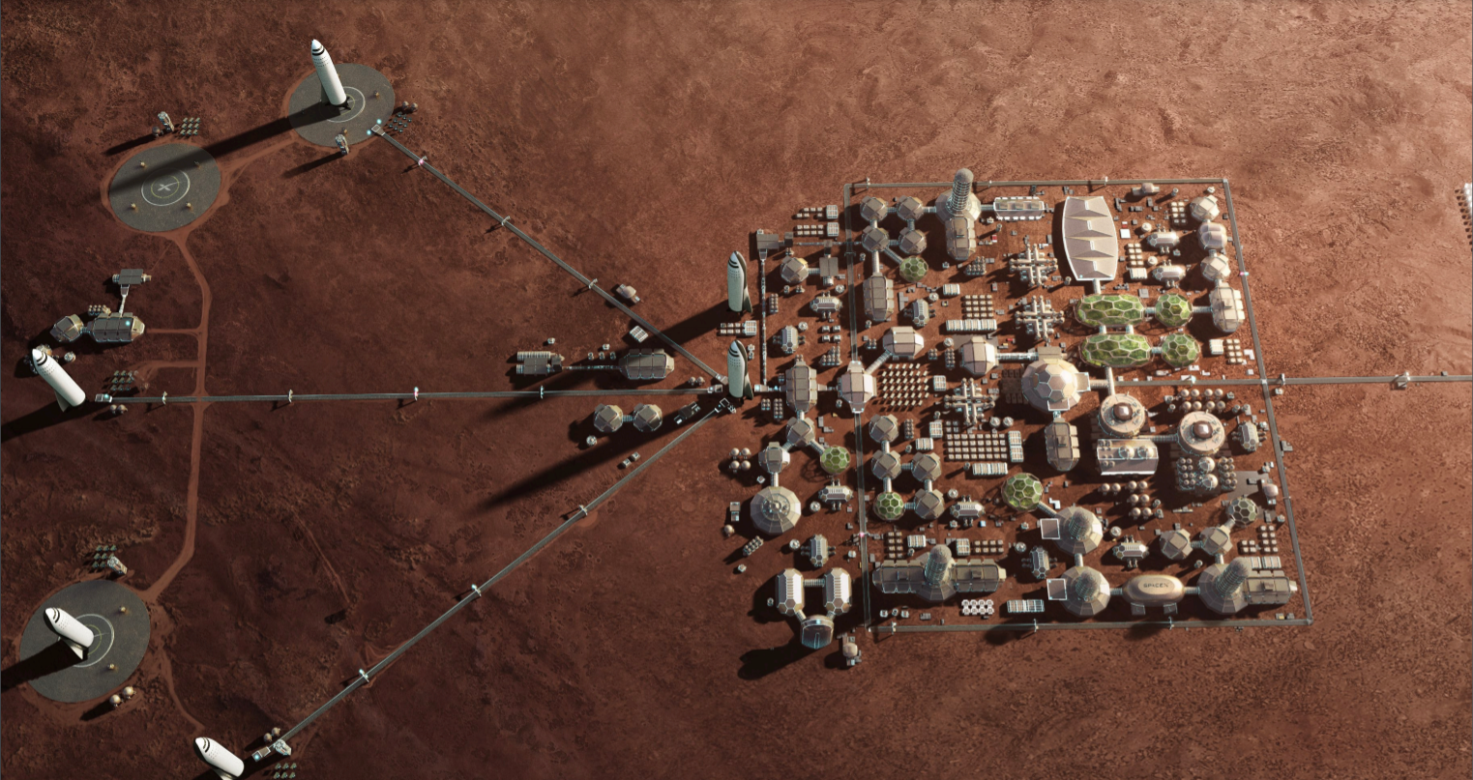

Slide 15
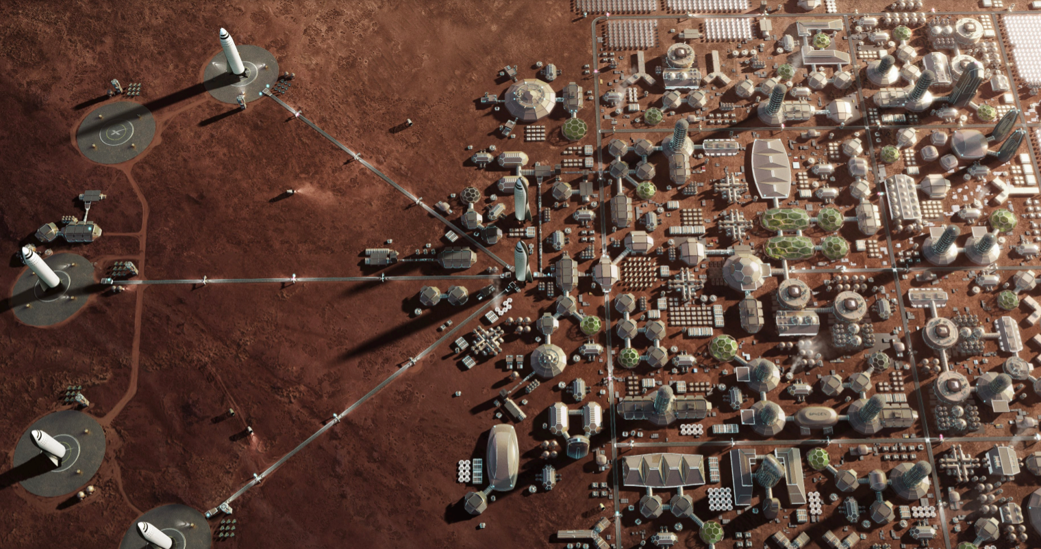

Slide 16
A lot is going on with Space…
What are we going to talk about today?

Slide 17


Slide 18
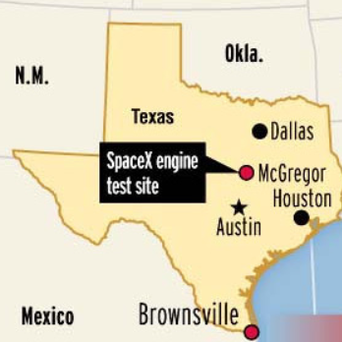
SpaceX
Starship Factory & Launch Facility

Slide 19


Slide 20
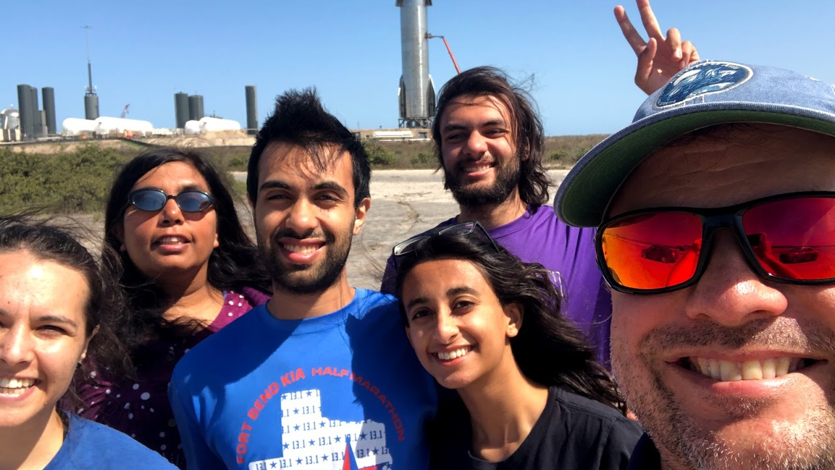

Slide 21
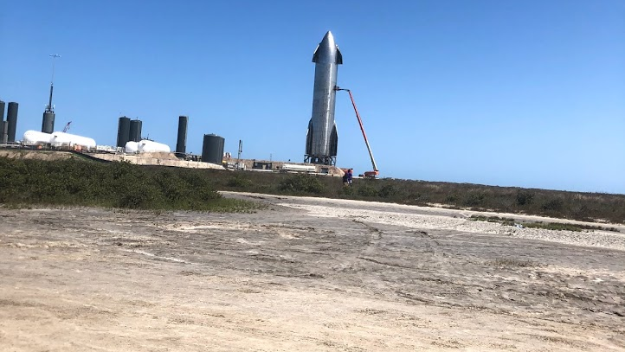

Slide 22
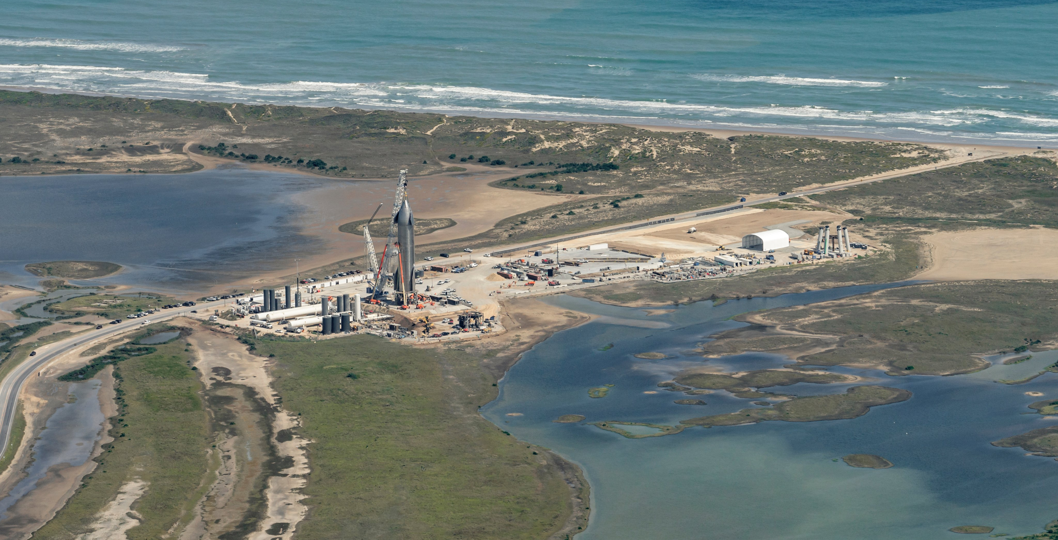

Slide 23
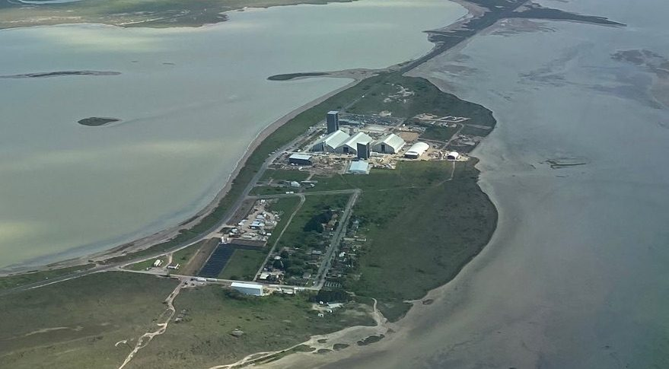

Slide 24
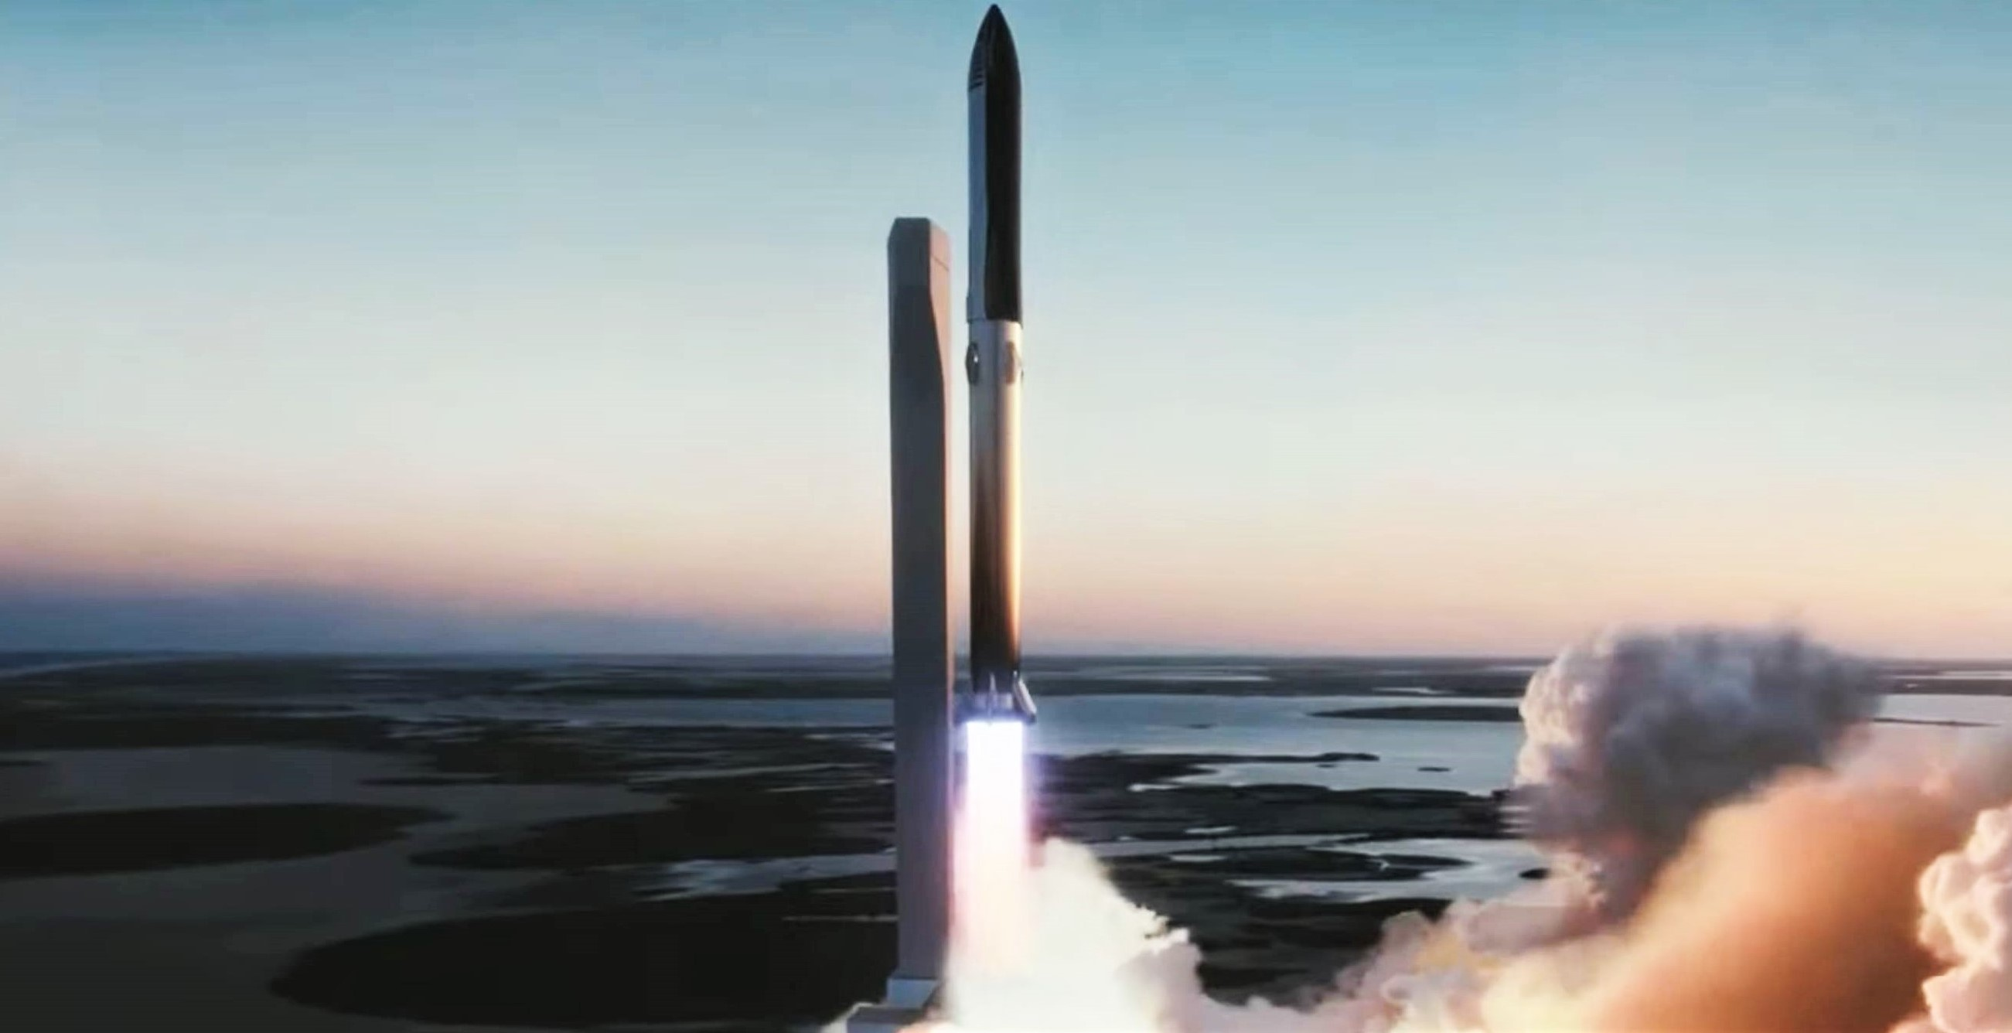

Slide 25
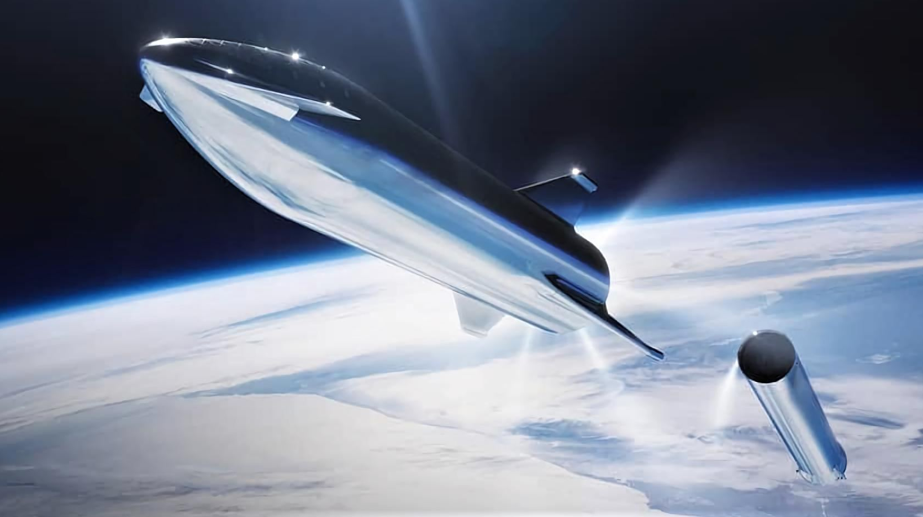

Slide 26
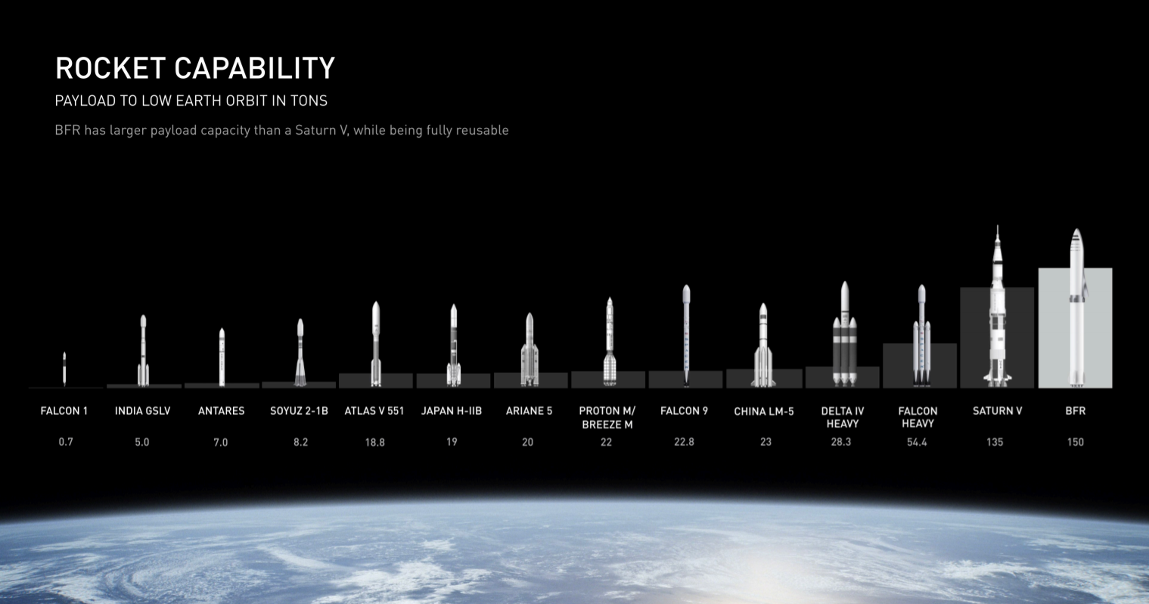

Slide 27
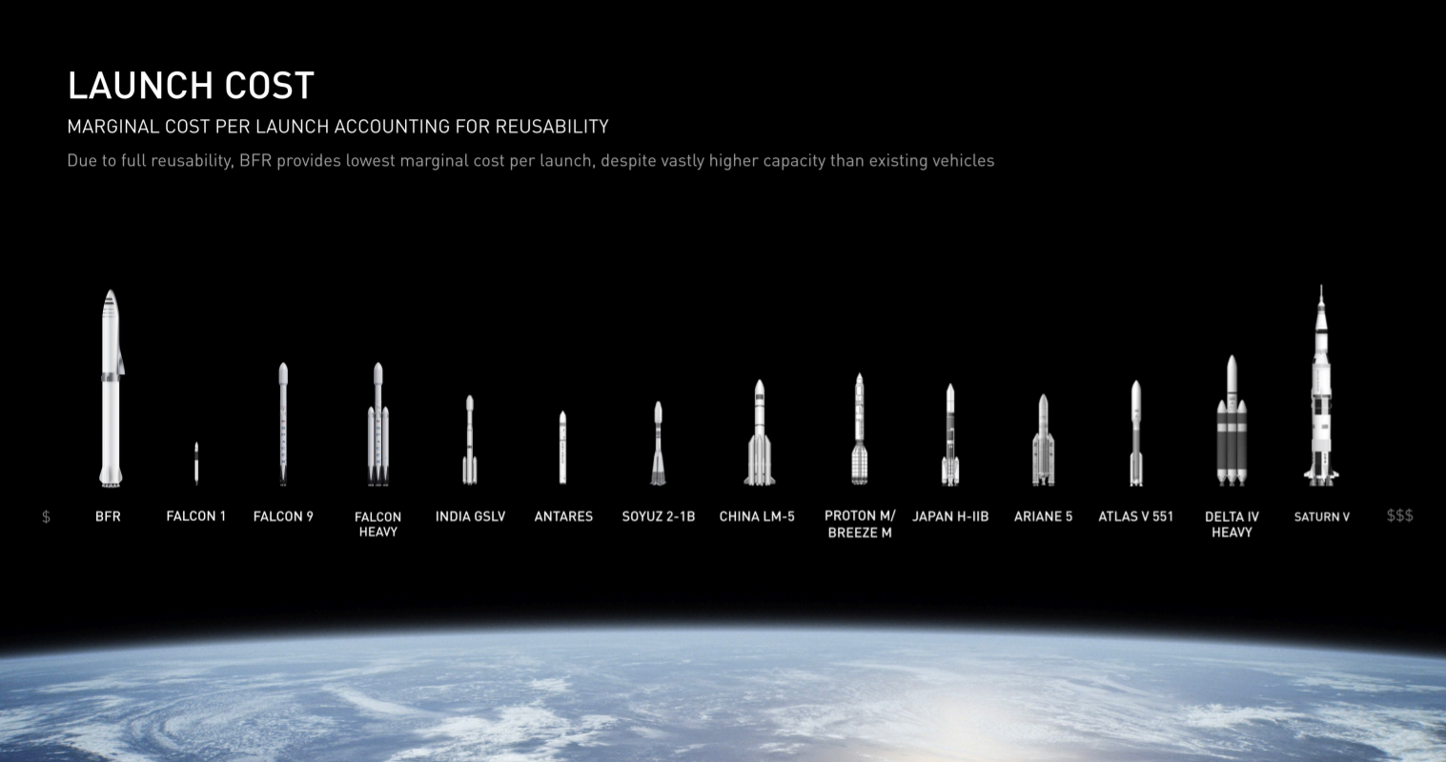

Slide 28
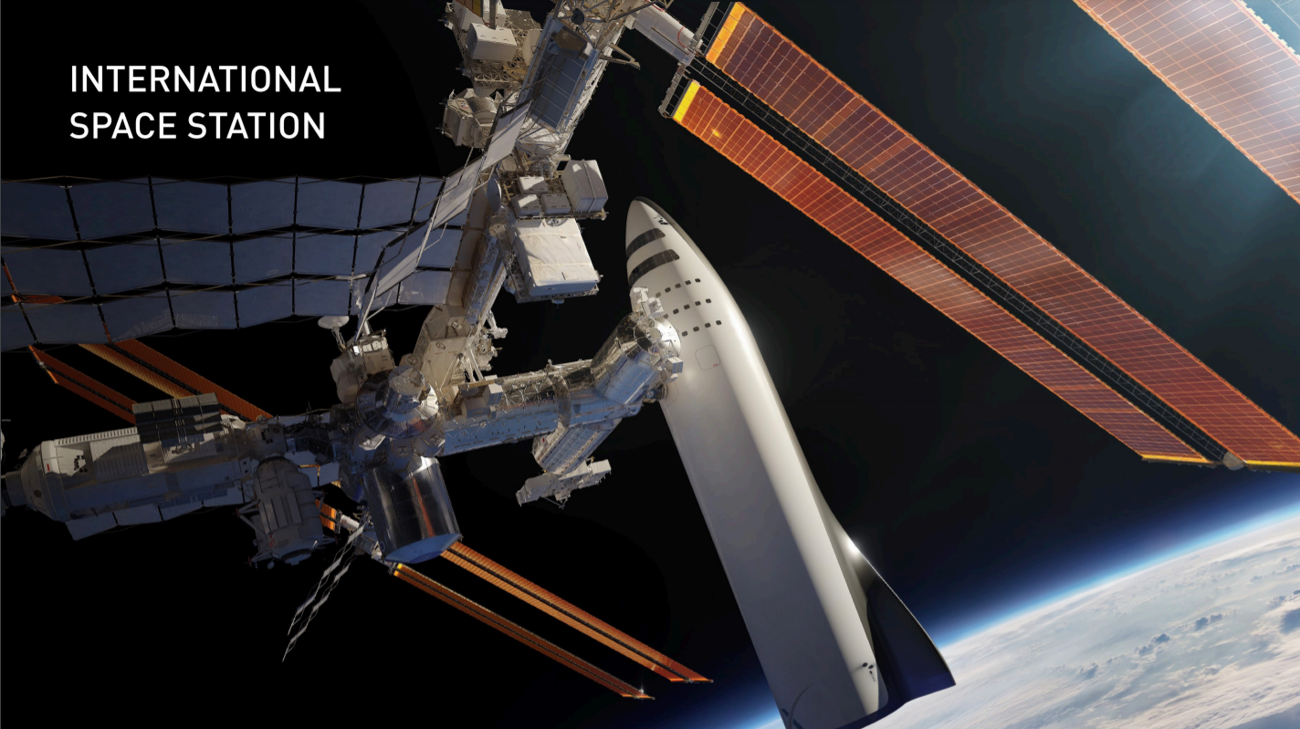
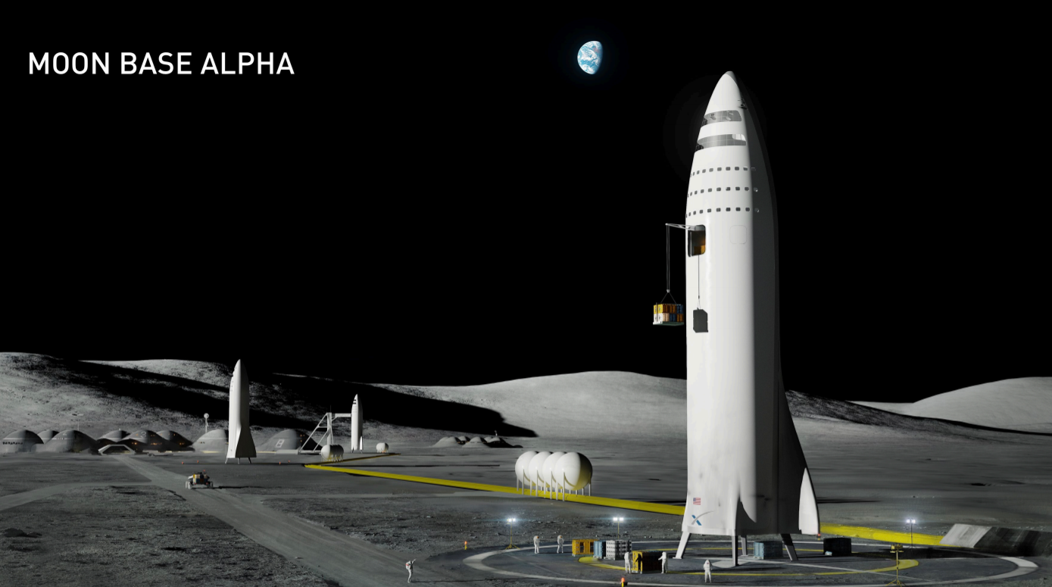

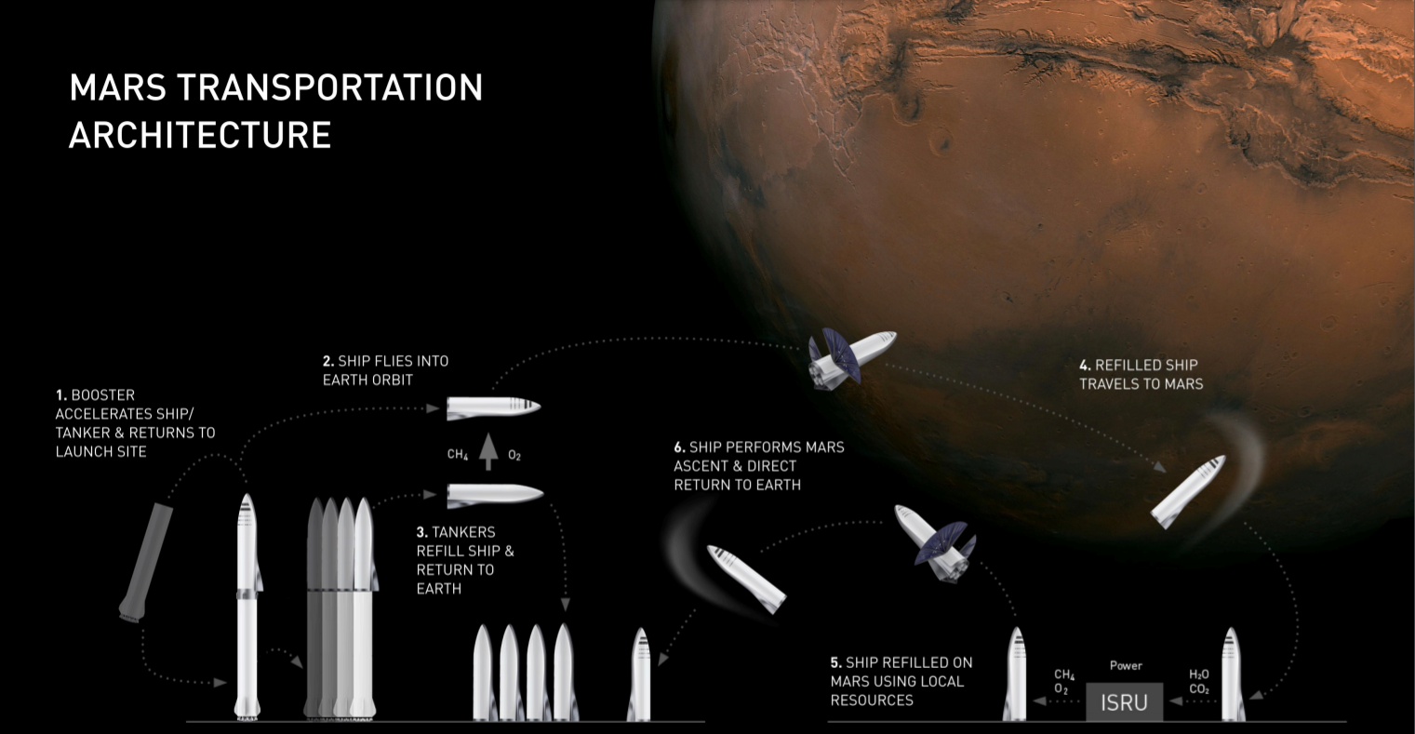

Slide 29


Slide 30
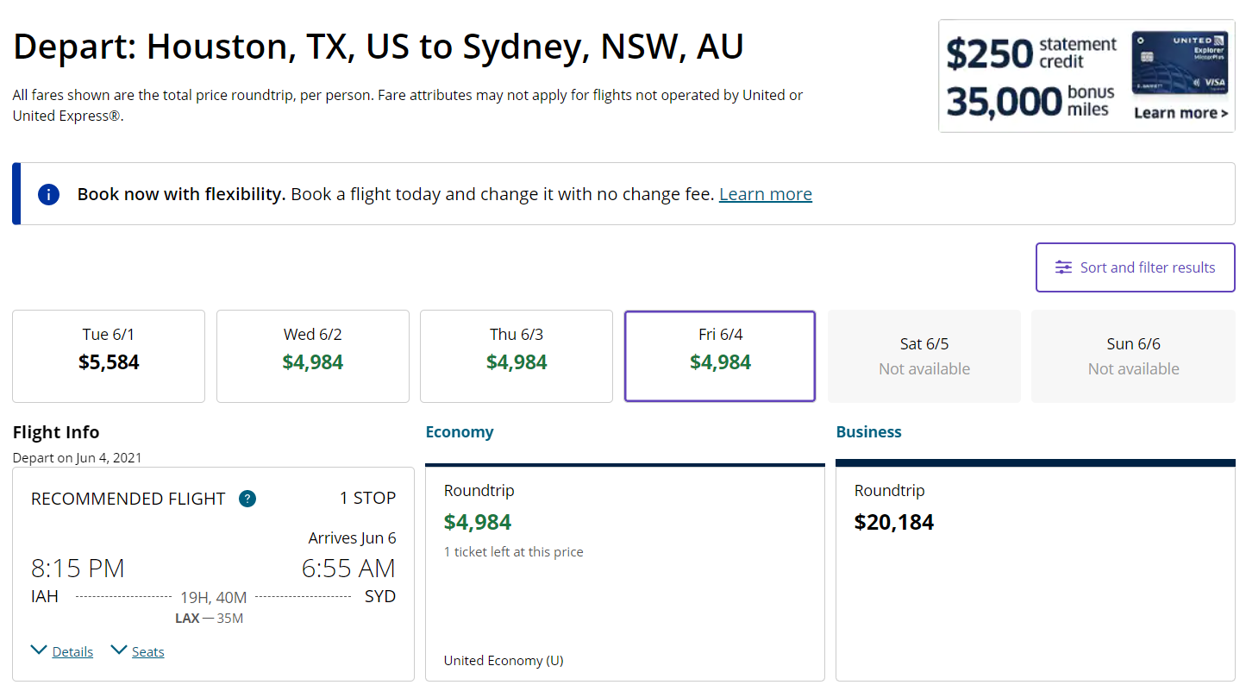

Slide 31
Predictions for 2030
Will be able to travel between every continent in less than 40 minutes
There will be daily flights into space
As common for people to go into space as for people today to go to Antarctica
Multiple Space Stations around the earth
Space station around the moon
A base on the moon
First landing of people on Mars

Slide 32

Questions?
Feedback?
Thoughts?

