Slide 1
GadgetNate’s Week in Review and Preview
January 17, 2021

Slide 2
Summary of Last week
Time Budget – 168 Hours In a Week
Space Goals:
North Houston Space Society
Publish video and notes about January 9 meeting
Prepare for business meeting
Countdown To The Moon (7 Interviews; 7 Reflections)
Begin application process for Professional Masters in Space Studies at Rice – Write first draft of personal statement, review application, think about letters of recommendation, start process to get transcripts, think about taking the GRE
Begin Outline for Rotary Club Speech “Humanity’s Future In Space”
Personal Goals:
Extreme time management and discipline
Run 3 days – 3 miles <11:50 minute/mile
Use the Tonal 3 Days
Read 100 pages in the book “The Worldly Philosophers” By Robert Heliborne (1/2 the book)
Buffer | 17 | 10
Sleep | 56 | 59
Work | 50 | 42
Family Time | 7 | 10
Space Related | 14 | 13
Personal | 24 | 34
-
X
X
Family Goals
Play family board game (Terraforming Mars?)
Call and talk to one family member that I haven’t talked to in a while
-
X
80

Slide 3
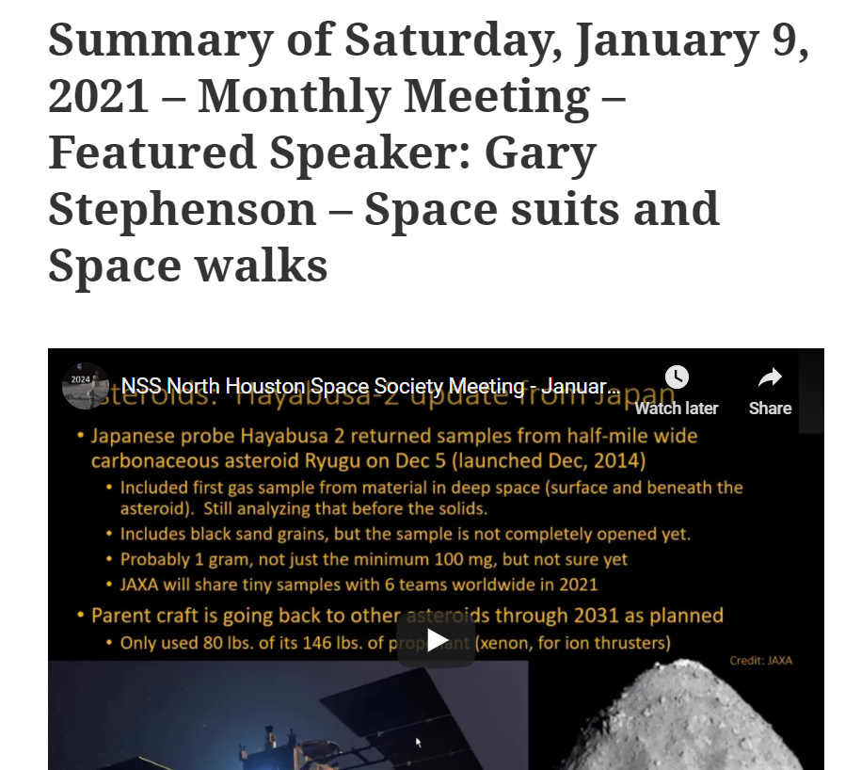
North Houston Space Society

Slide 4
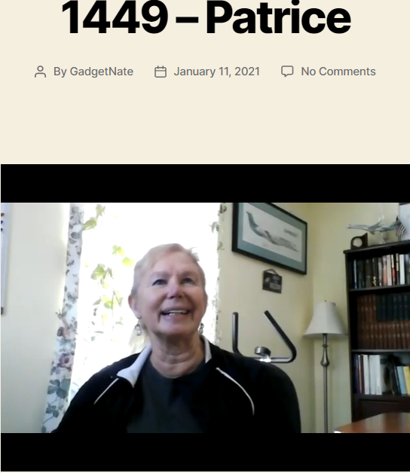
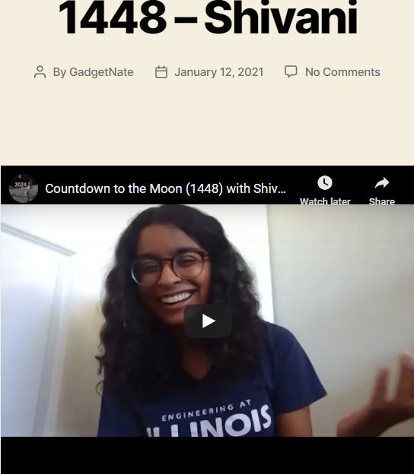
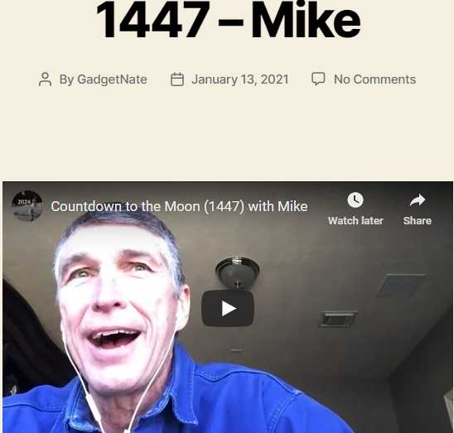
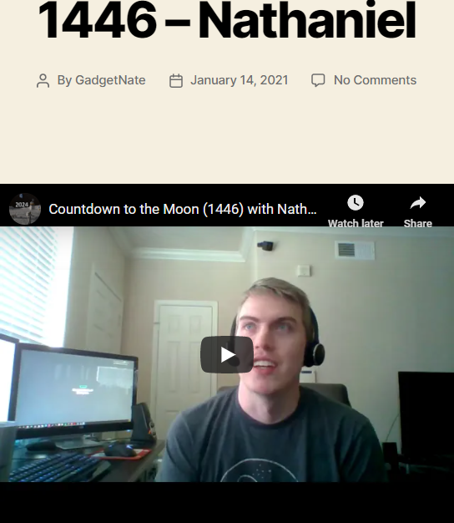
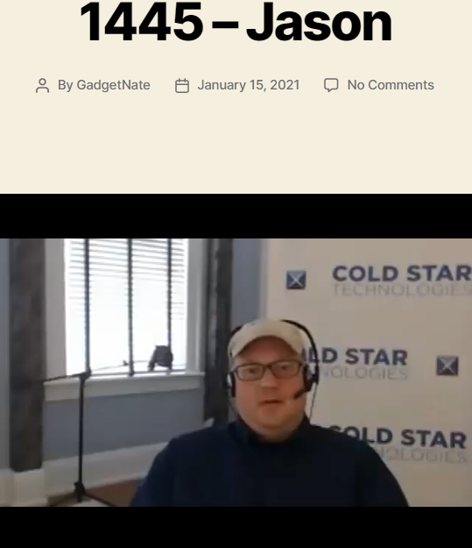
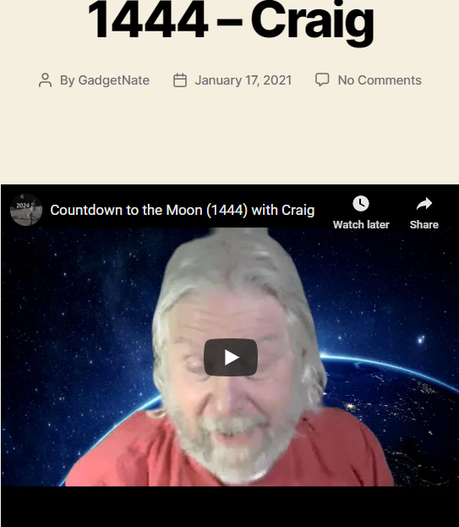
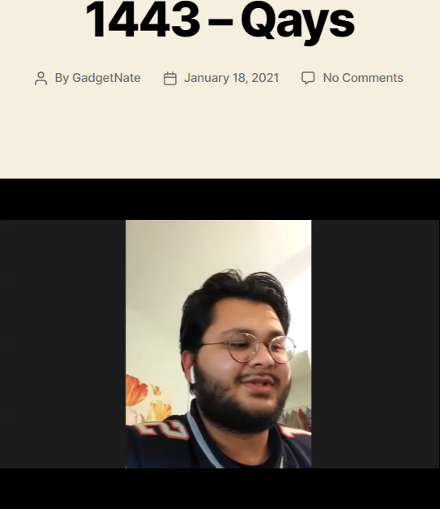
7 Countdown to the Moon Interview

Slide 5
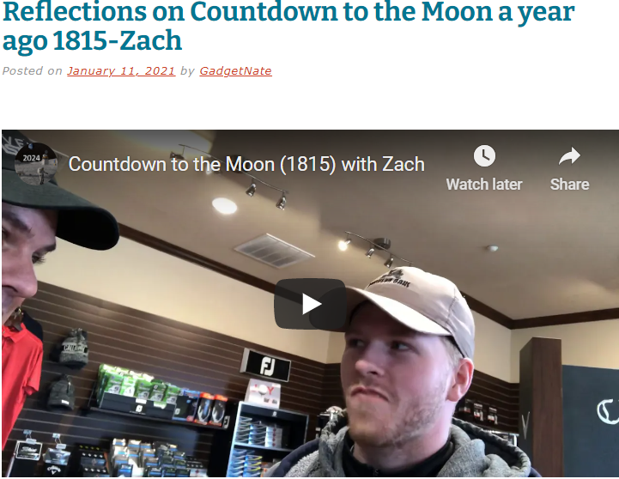
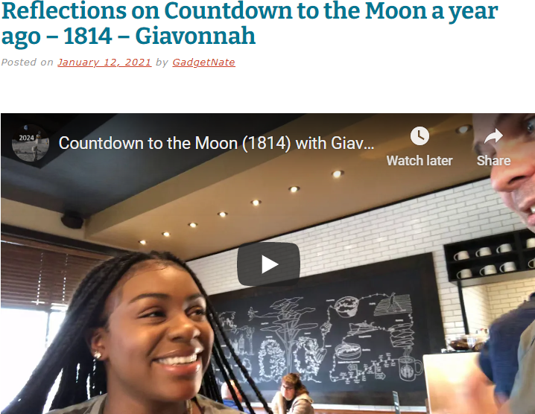
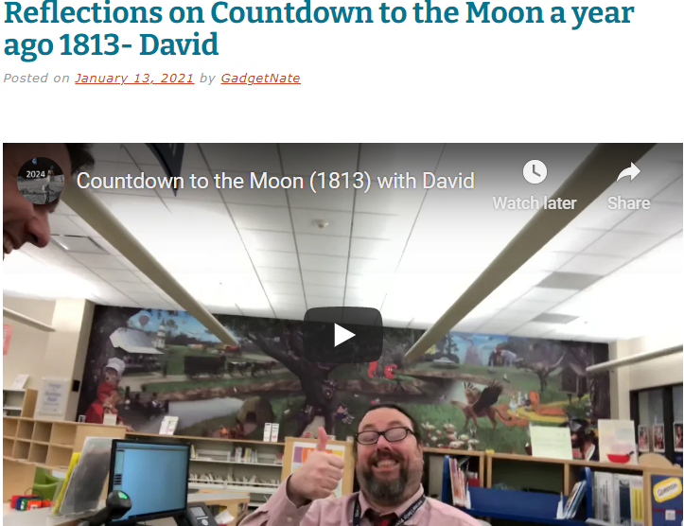
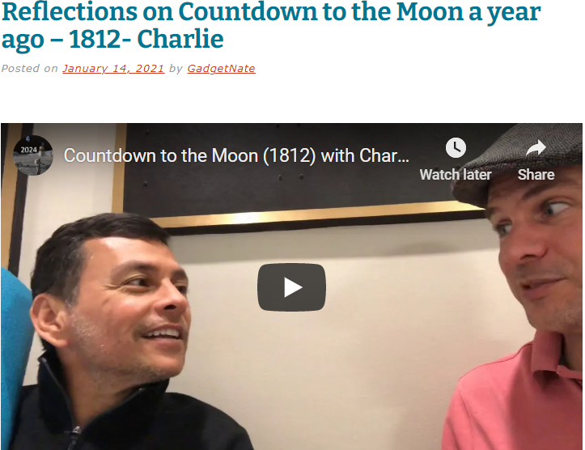
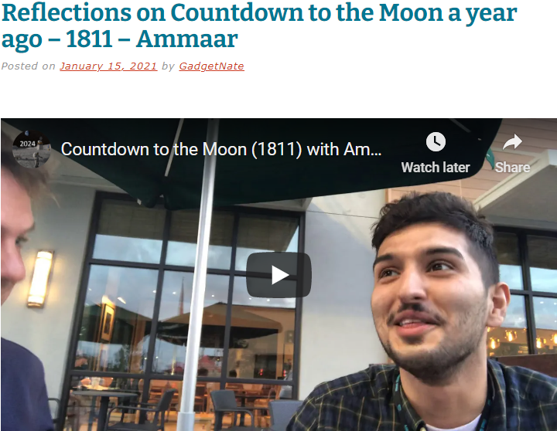
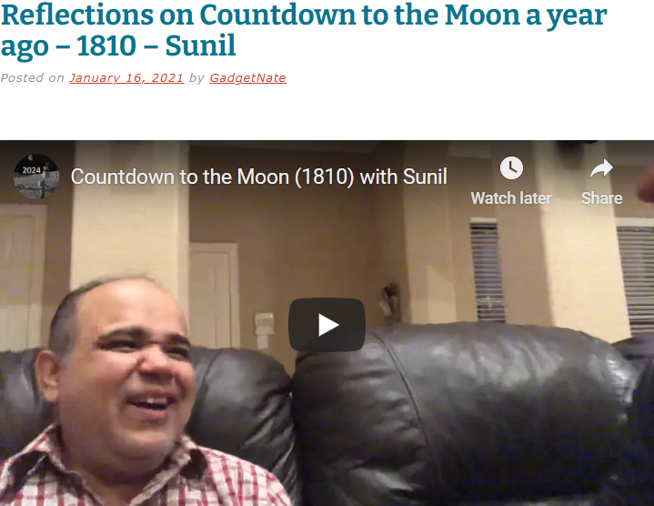
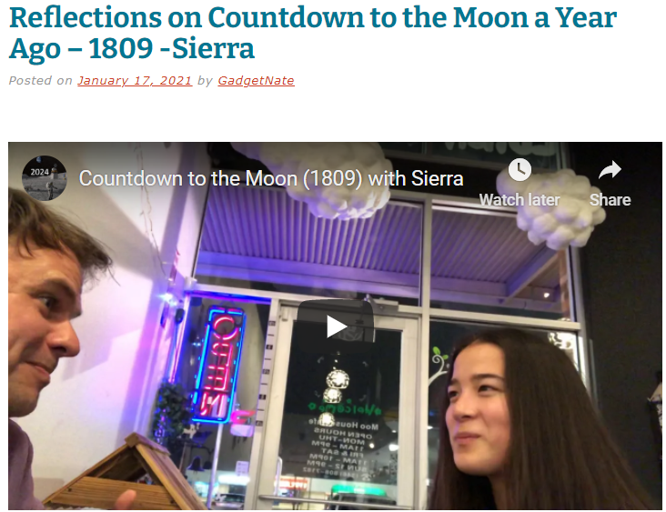
7 Review of last year’s Countdown to the Moon Interviews

Slide 6
Run 3 days – 3 miles <11:50 minute/mile
Monday – 3.00 Miles 10:55 min/mile
Wednesday – 3.01 – 11:22 min/mile
Friday – 3.02 – 11:08 min/mile

Slide 7
Plans for the coming week
Time Budget – 168 Hours In a Week
Space Goals:
North Houston Space Society
Prepare for business meeting
Promote Next Space meeting
Countdown To The Moon (7 Interviews; 7 Reflections)
Begin application process for Professional Masters in Space Studies at Rice – Write first draft of personal statement, review application, think about letters of recommendation, start process to get transcripts, think about taking the GRE
Begin Outline for Rotary Club Speech “Humanity’s Future In Space”
Personal Goals:
Extreme time management and discipline
Run 3 days – 3 miles <11:45 minute/mile
Use the Tonal 3 Days
Read 70 pages in the book “The Worldly Philosophers” By Robert Heliborne (1/2 the book)
Buffer | 17
Sleep | 56
Work | 50
Family Time | 7
Space Related | 14
Personal | 24

