Slide 1
GadgetNate’s Week in Review and preview
Review: Monday, December 21, 2020 – Sunday, December 27, 2020
Preview: Dec. 28, 2020 – Jan 3, 2021

Slide 2
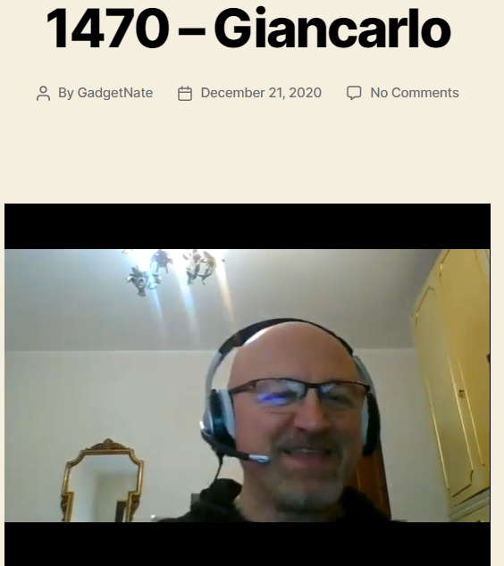
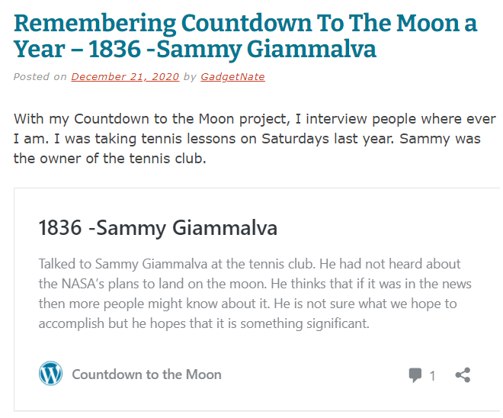
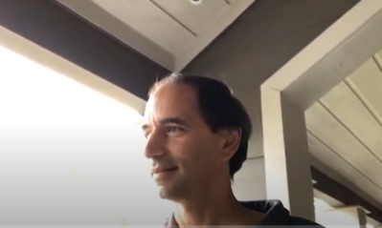
Monday, December 21, 2020

Slide 3






Monday, December 21, 2020
North Houston Space Society conduct its first Elections and Business Meeting!
Nathan Price
President
Greg Stanley
Vice President
Masha Esfand
Secretary
Keith Duazat
Treasurer
Dr. Heather Domjan
Director
C. Stuart Hardwick
Director
Also decided on the meeting dates for our monthly outreach meetings and our next business meeting

Slide 4
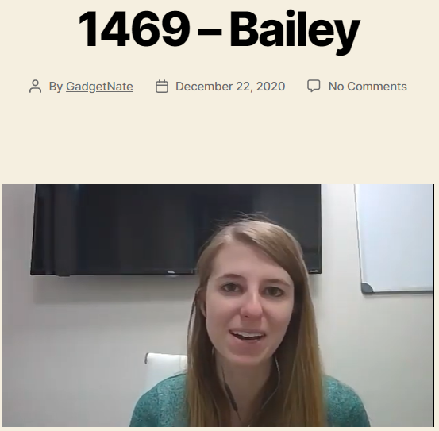
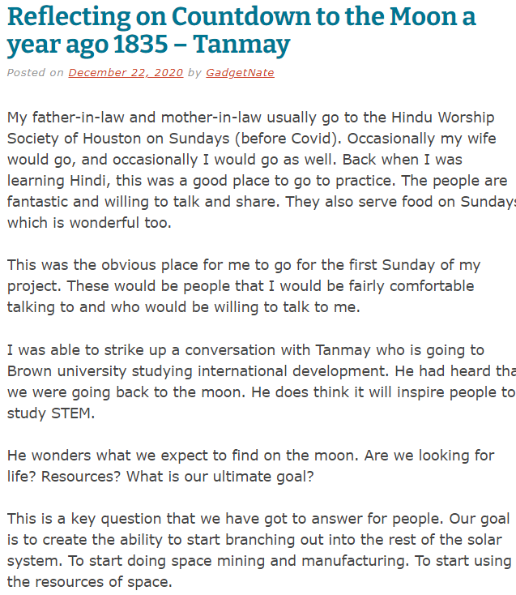
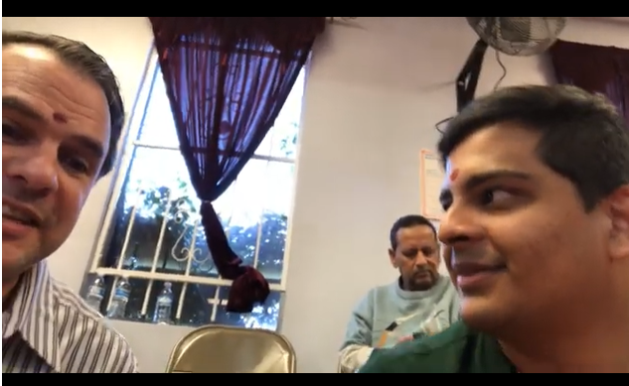
Tuesday, December 22, 2020

Slide 5
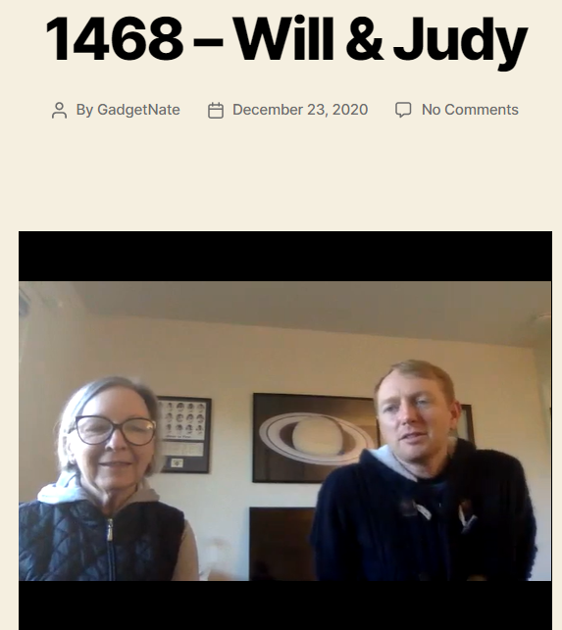
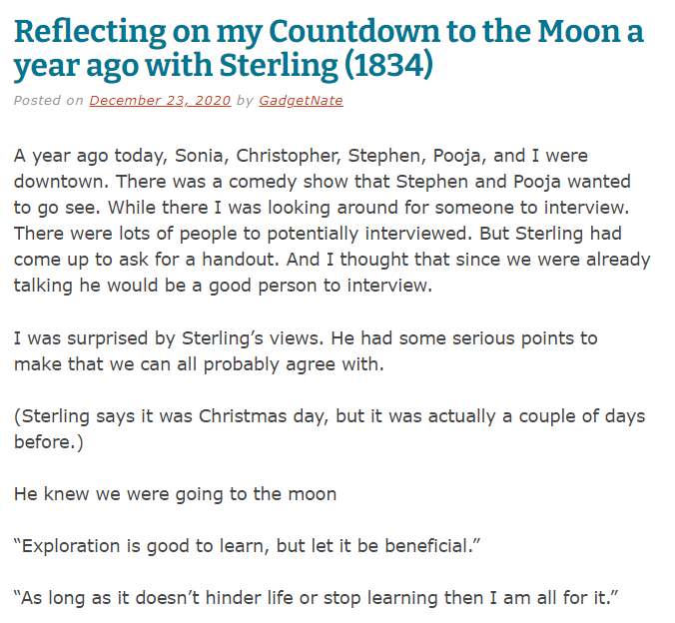

Wednesday, December 23, 2020

Slide 6
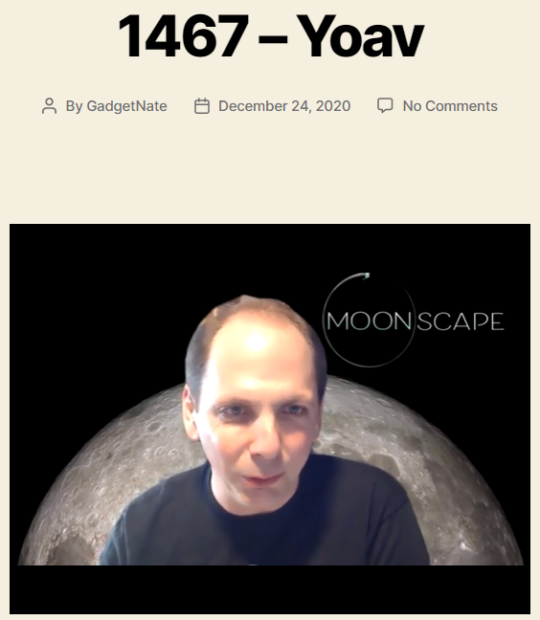
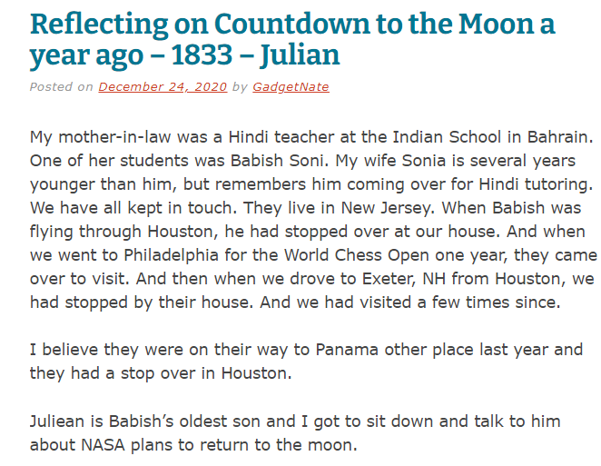


Thursday, December 24, 2020

Slide 7
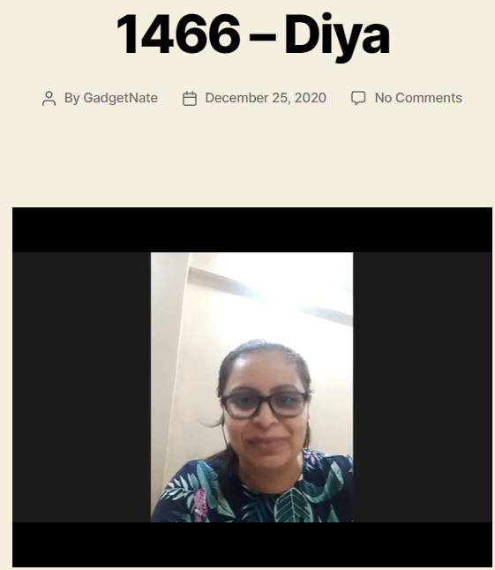
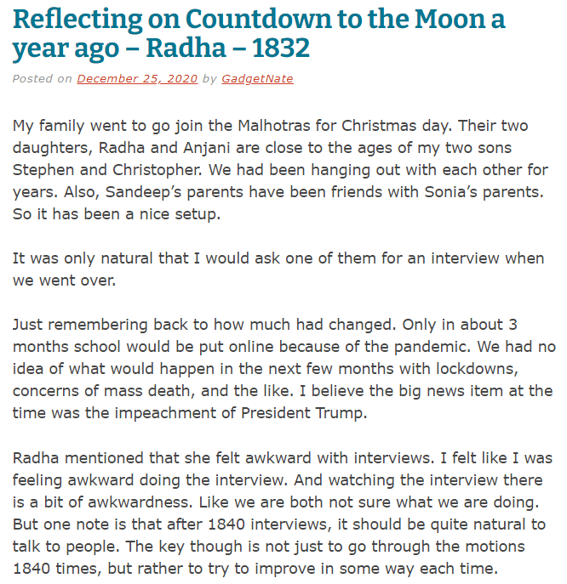
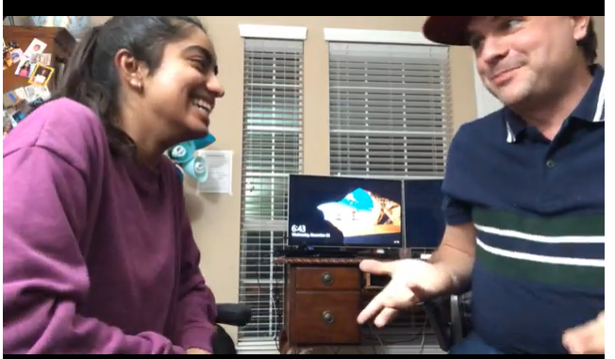
Friday, December 25, 2020

Slide 8
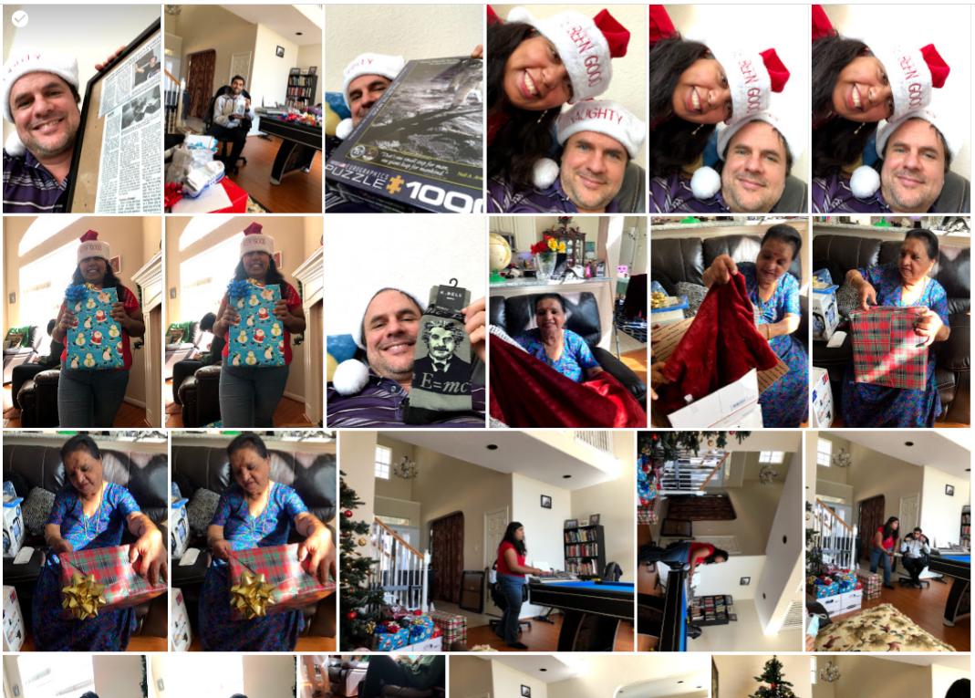
Friday, December 25, 2020
Christmas Celebration

Slide 9
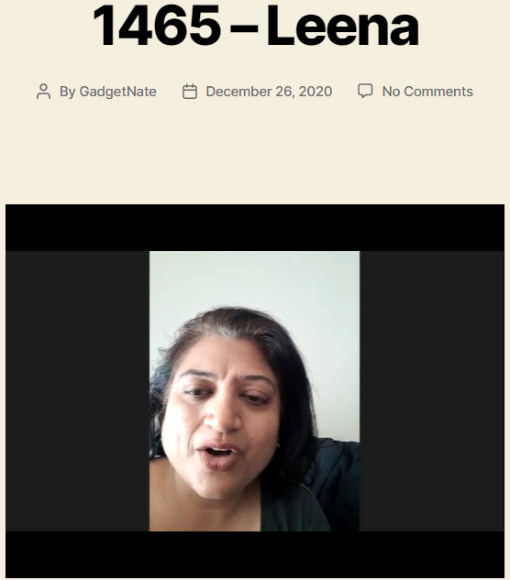
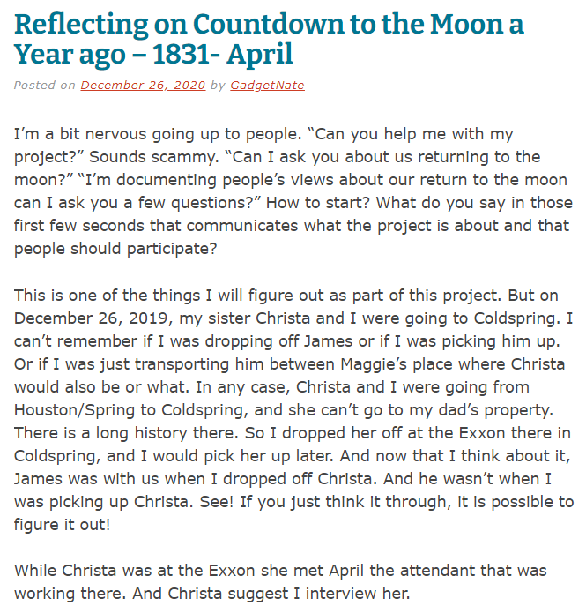

Saturday, December 26, 2020

Slide 10
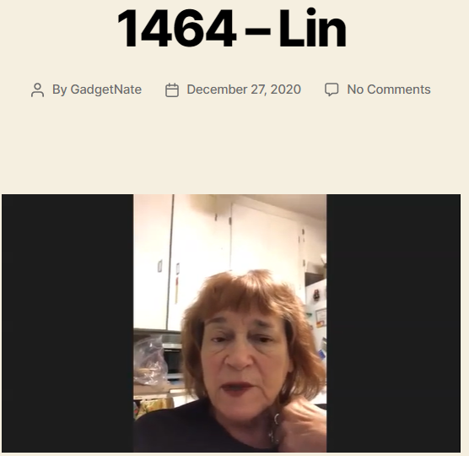

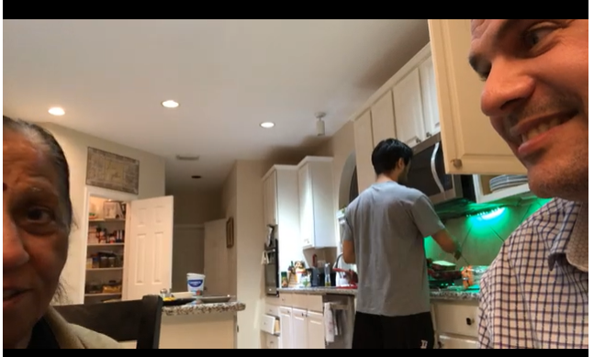
Sunday, December 27, 2020

Slide 11
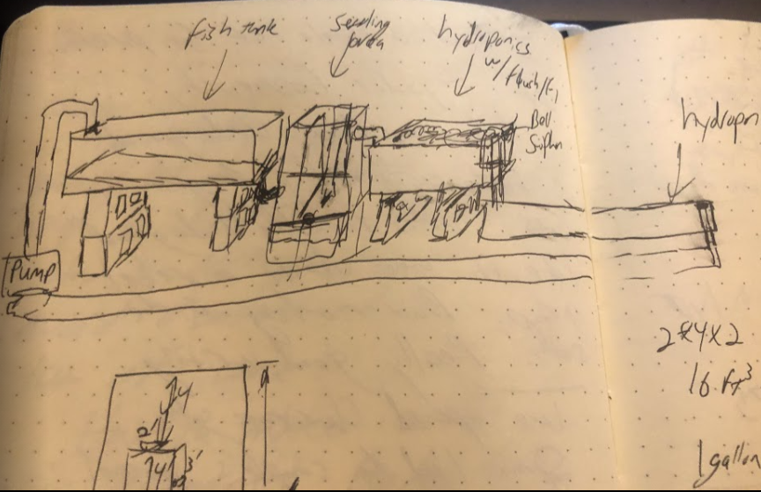
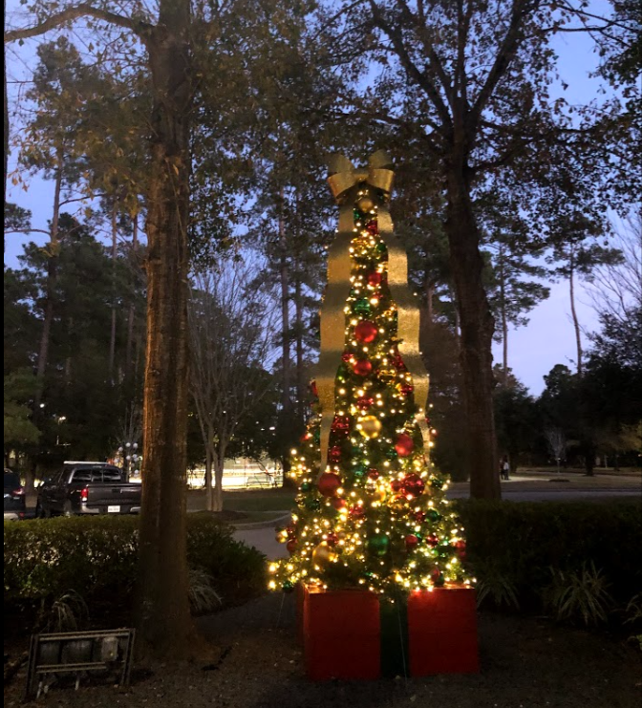
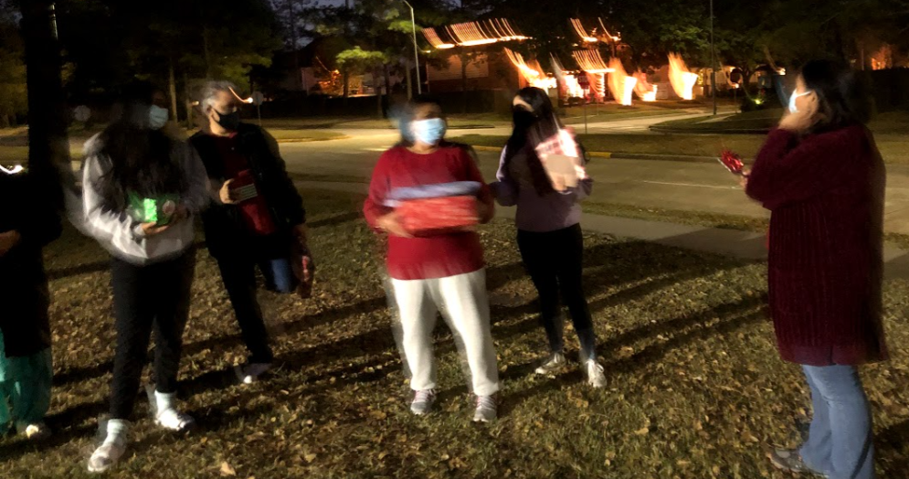




Slide 12

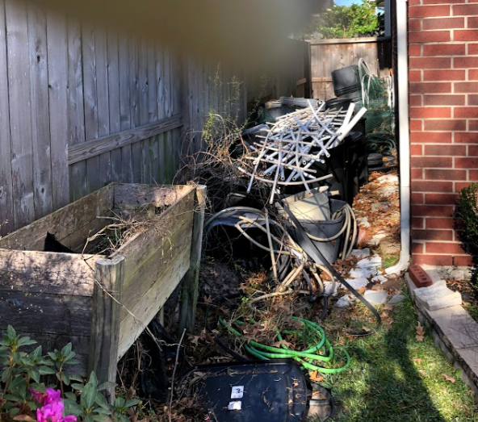
Accomplishments for the Week
7 Countdown to the Moon Interviews
7 Review of last year’s Countdown to the Moon Interviews
North Houston Space Society – First Elections, First Business meeting; 2020 chapter report draft complete; Monthly outreach meetings Set and Next Business Meeting Set
Successful Christmas Celebration
Significant Winter Cleaning
No Coffee or Tea
Prepare for arrival of Tonal

Slide 13
Plans for the Week
7 Countdown to the Moon Interviews
7 Review of last year’s Countdown to the Moon Interviews
Put Countdown to the Moon on a micro SD Card
Complete North Houston Space Society Chapter Report
Market the Jan 9th North Houston Space Society Meeting
Finish Reading “Notes from underground” by Fyodor Dostoevsky
Exercise 7 days on the Tonal
Run 3 days this week (3 miles each) – Less than a 12 minute mile
No Coffee – No TEA
Enjoy my last 7 days of vacation!

